Slide 1

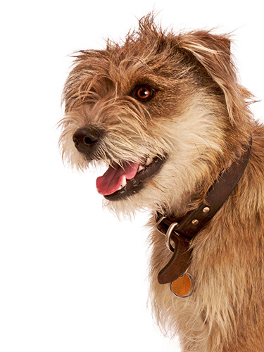
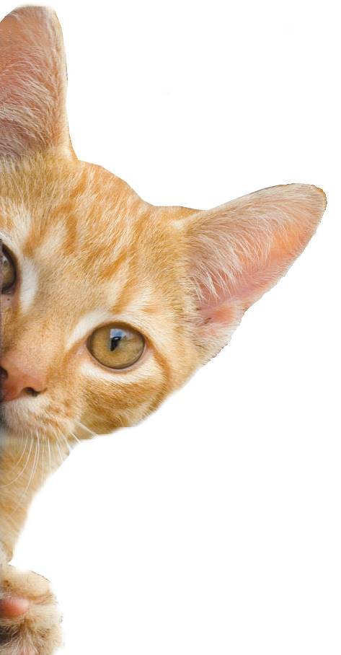
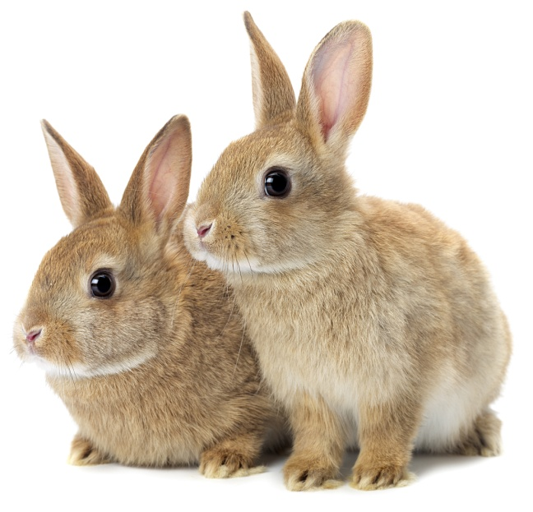
Are you Alive?
Notes:
Share:
Introduce the session and PDSA.
Tell children that PDSA treat the sick and injured pets of people in need...
Explain that PDSA is a special kind of vets, because they’re a charity. Discuss what a charity is and explain that PDSA looks after pets when owners can’t afford vet treatment.
Ask:
If they think it’s important to help sick and injured animals to get better?
What would happen to all the sick and injured pets PDSA treat if they weren’t around?
Share:
Tell them that today, you’re all going to learn about what pets need to be healthy and happy and also about some of the pets that PDSA has helped in their Pet Hospitals.

Slide 2
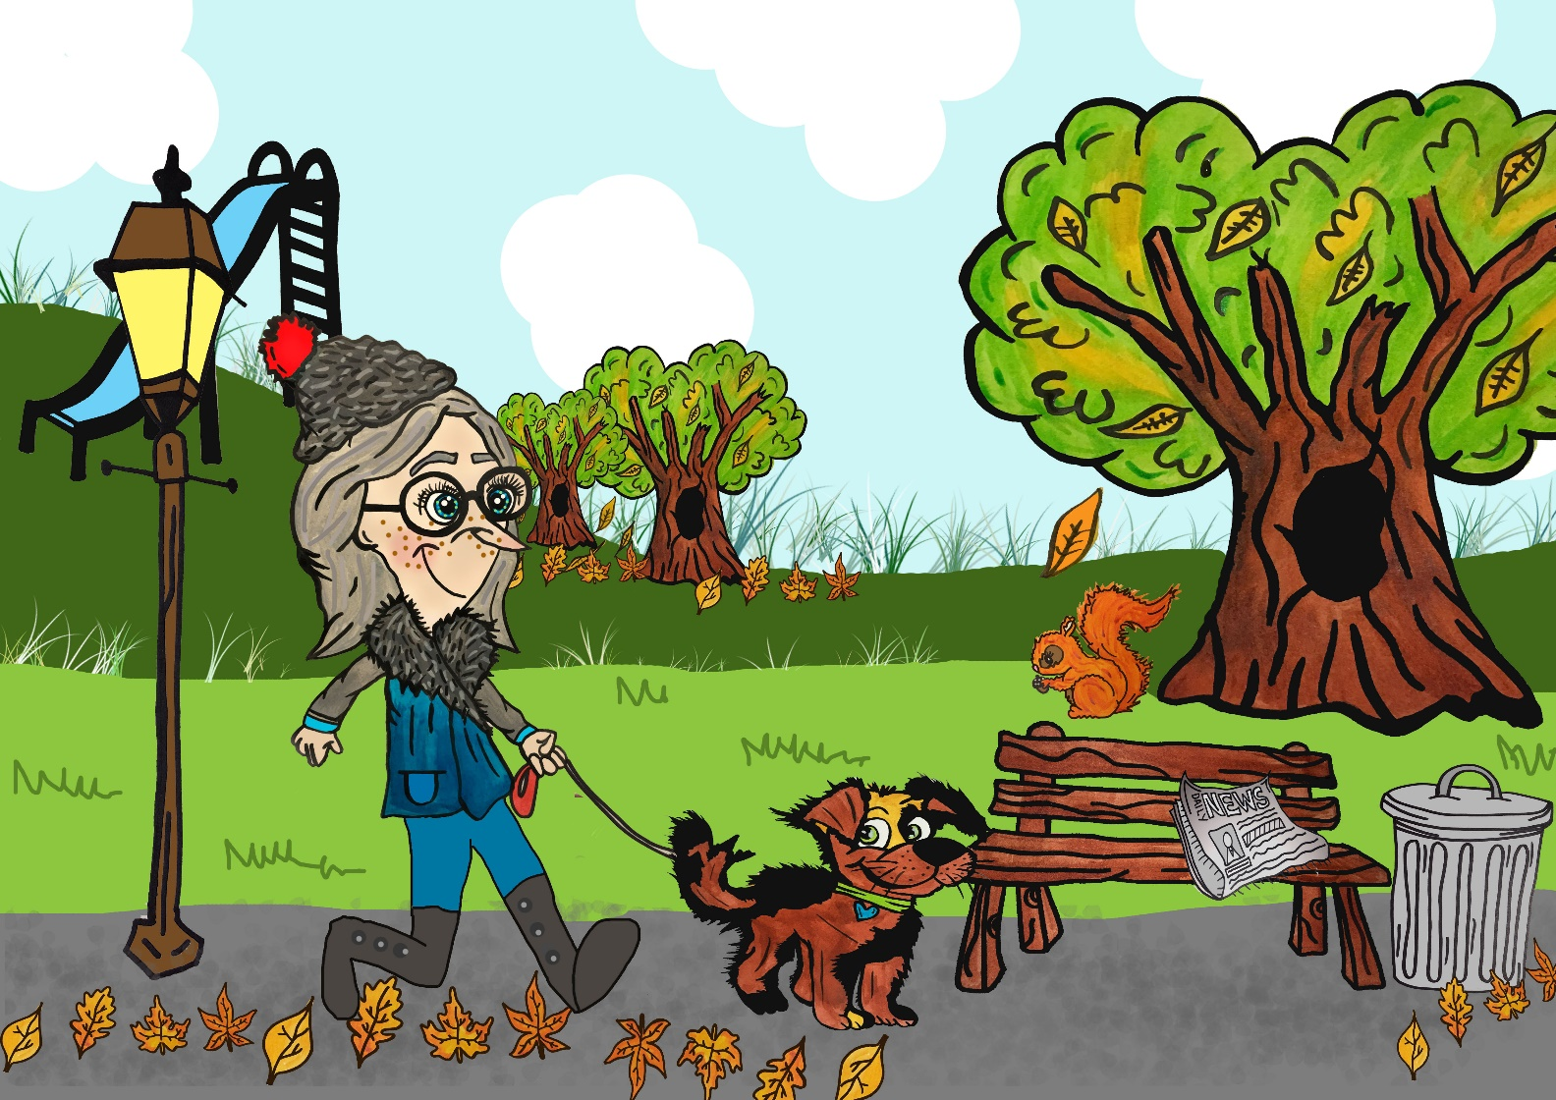
Can you find all the items that are:
alive
dead?
Notes:
Share:
Introduce the session and PDSA.
Tell children that PDSA treat the sick and injured pets of people in need...
Explain that PDSA is a special kind of vets, because they’re a charity. Discuss what a charity is and explain that PDSA looks after pets when owners can’t afford vet treatment.
Ask:
If they think it’s important to help sick and injured animals to get better?
What would happen to all the sick and injured pets PDSA treat if they weren’t around?
Share:
Tell them that today, you’re all going to learn about what pets need to be healthy and happy and also about some of the pets that PDSA has helped in their Pet Hospitals.

Slide 3


Learning Objectives
I will understand that animals, including humans, are alive.
I will be able to sort living and non-living objects into categories.
Learning Outcomes
P
I can explain how I know that a human or animal is alive.
I can sort objects into groups and explain my choices.
I can identify dead objects that were once alive and use a Venn diagram.

Slide 4
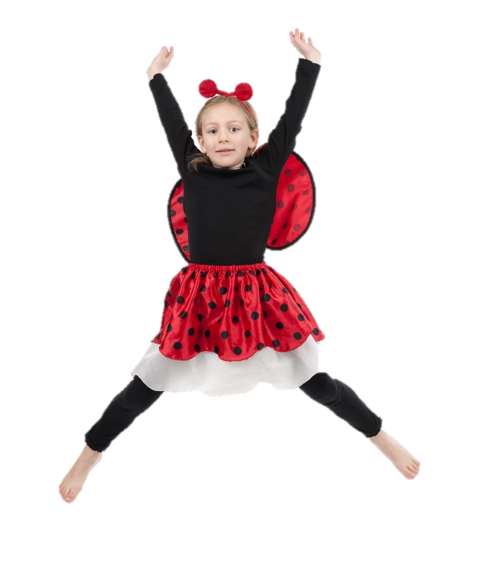

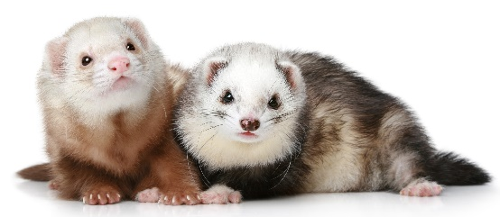
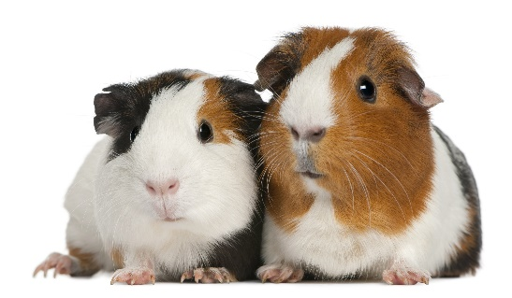

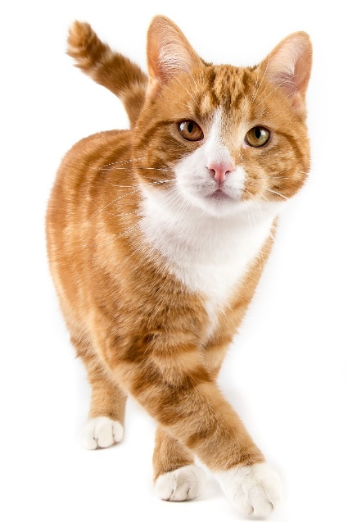
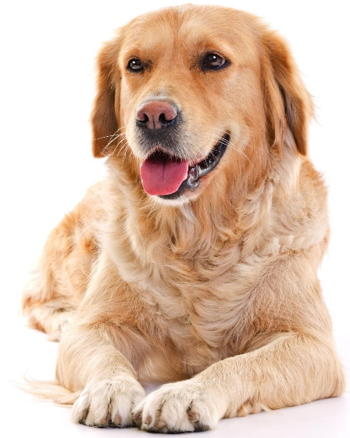
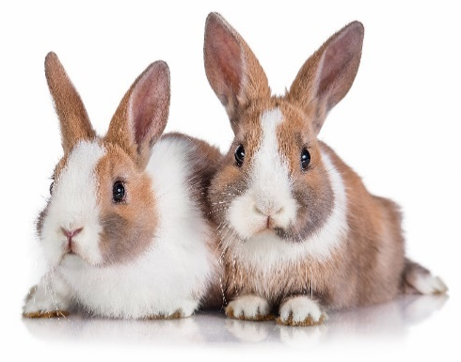
Animals and people are living things

Slide 5





A HOME
FRIENDS
HEALTH
FOOD & WATER
EXERCISE & FUN
What do pets need?…
Notes:
All pets, whether they’re large or small, need the same five things to keep them healthy and happy:
The right kind of safe, warm home with lots of space
The right kind of food and 24 hour access to fresh water
Exercise and fun (the chance to show normal behaviour)
Friends (This can be other animals, people, or both)
Health ( We all need to make sure our pets are kept healthy and take them to the vet when they’re not well)
Ask whose responsibility it is to keep pets healthy and happy and confirm that owners are responsible for looking after their pet properly.

Slide 6
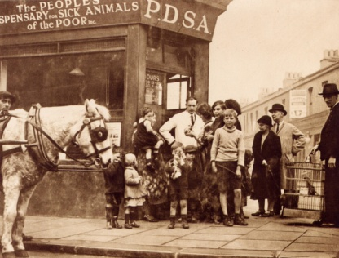
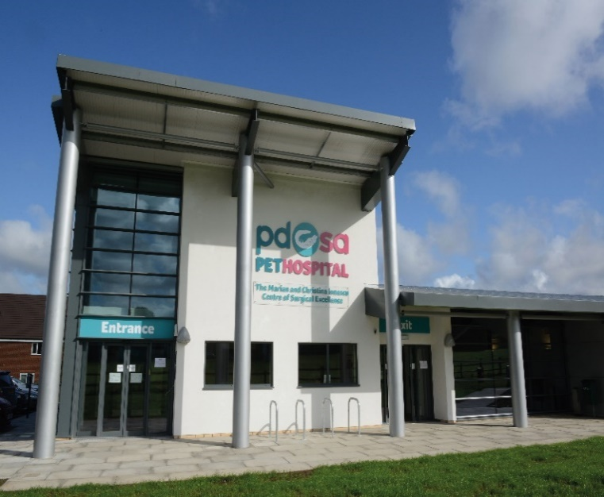
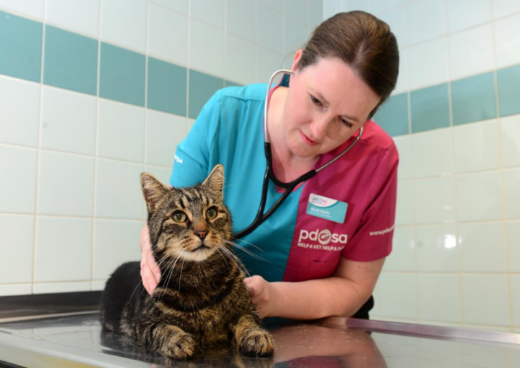
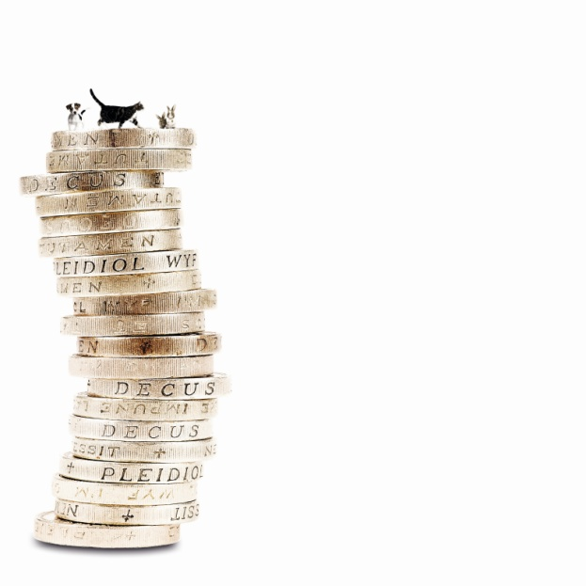
The UK’s leading vet charity …
PDSA is a 100 year old charity who have been treating sick and injured pets since 1917
They have Pet Hospitals all over the UK
They help one sick or injured pet every 5 seconds!
It costs the charity more than
£1 million every week to do their work
Notes:
Share the details on the slide and:
Tell children that PDSA treat the sick and injured pets of people in need..
Ask them if they think it’s important to help sick and injured animals to get better.
Explain that PDSA is a special kind of vets, because they’re a charity. Ask them what a charity does and explain that PDSA looks after pets when owners can’t afford vet treatment.
Ask them what would happen to all the sick and injured pets PDSA treat if they weren’t around.

Slide 7
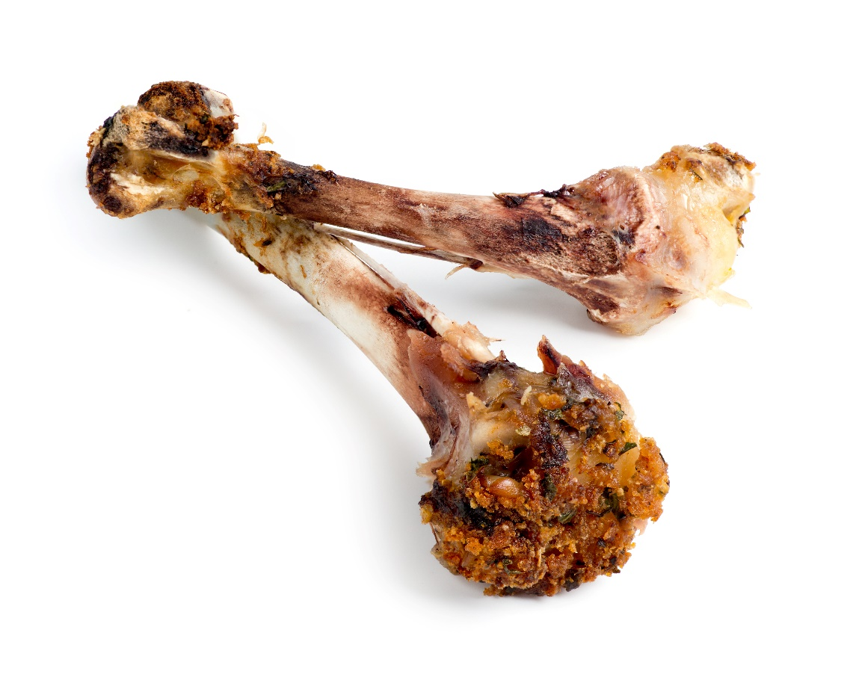
Bones are dead…
…but they were once part of a living person or animal

Slide 8
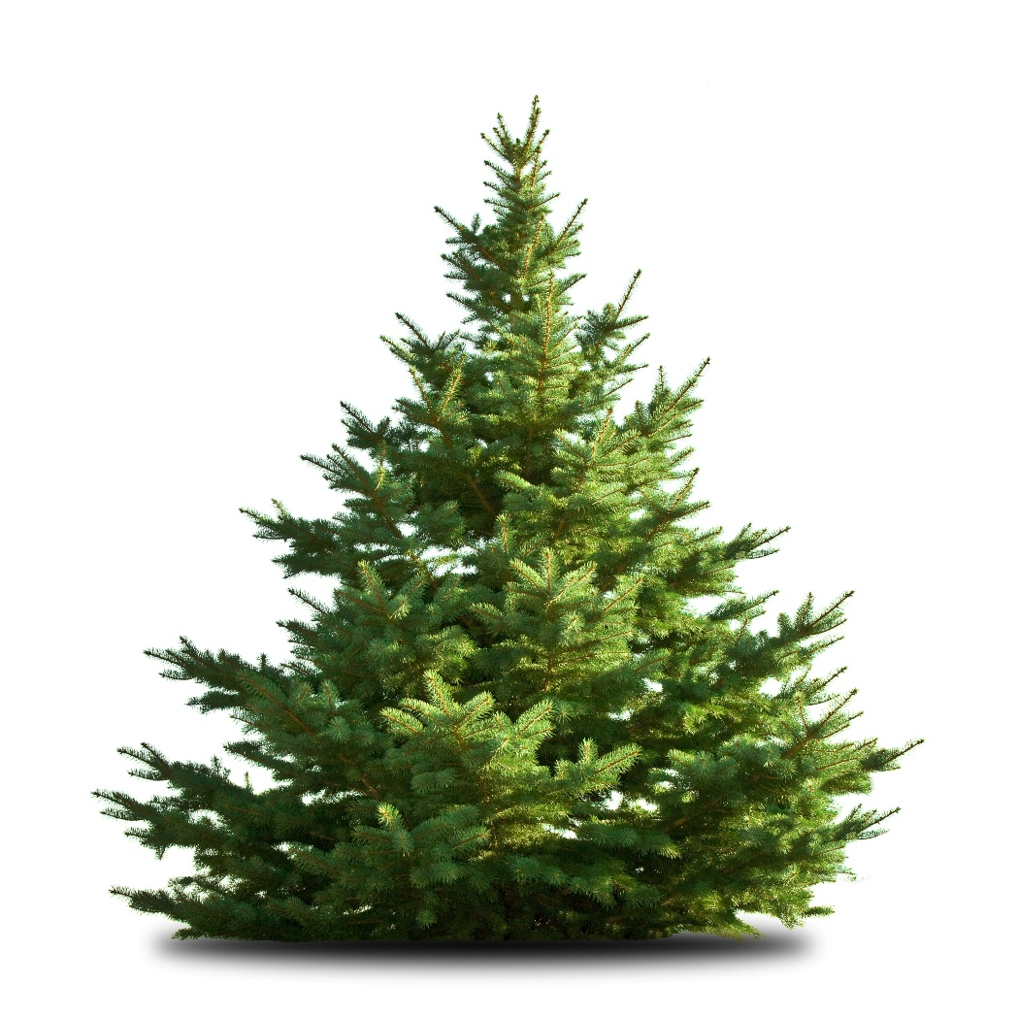
Trees are living things

Slide 9

Dry leaves on the ground are dead…
…but they were once part of a living tree

Slide 10

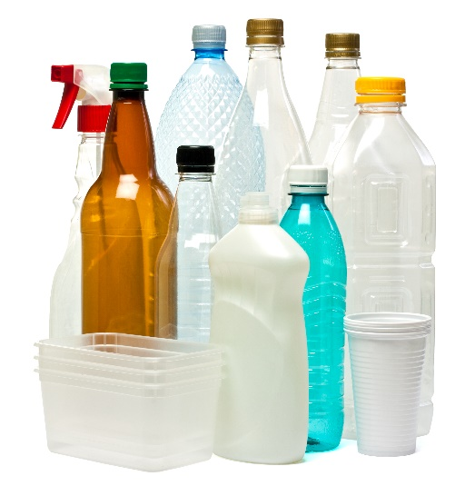
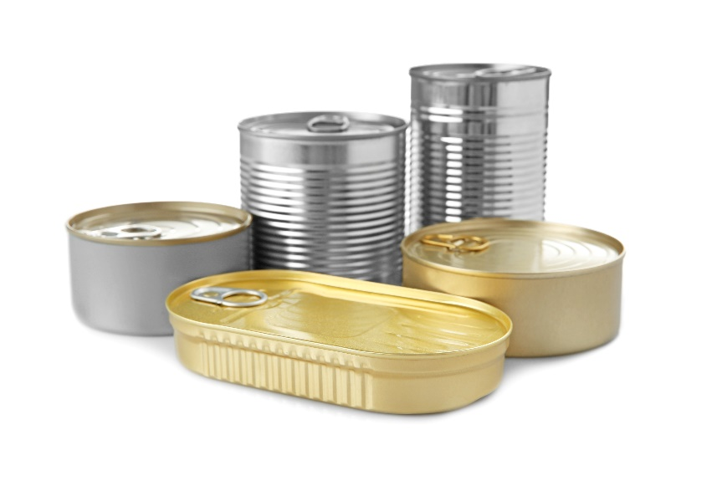
stone
Anything or has never been alive.
metal,
plastic

Slide 11
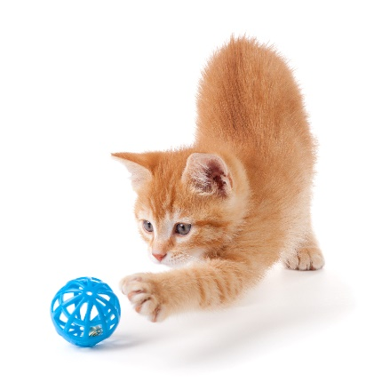
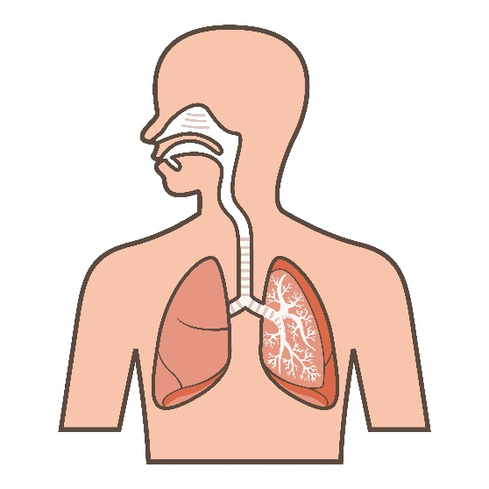
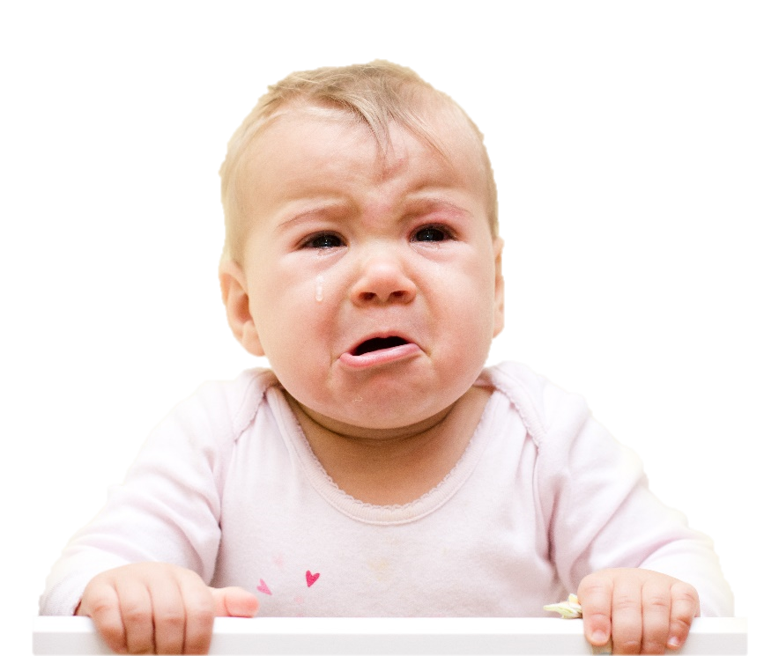

Living test
Can it move?
Can it grow?
Can it breathe?
Does it react?

Slide 12
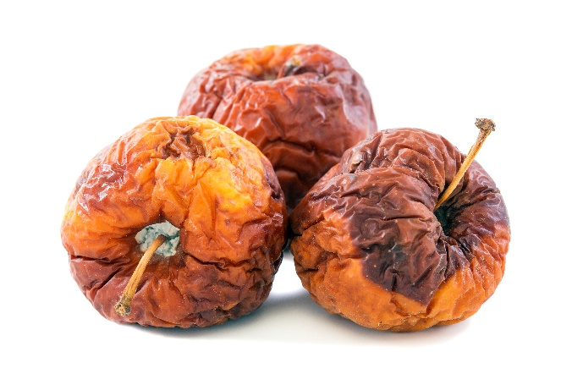
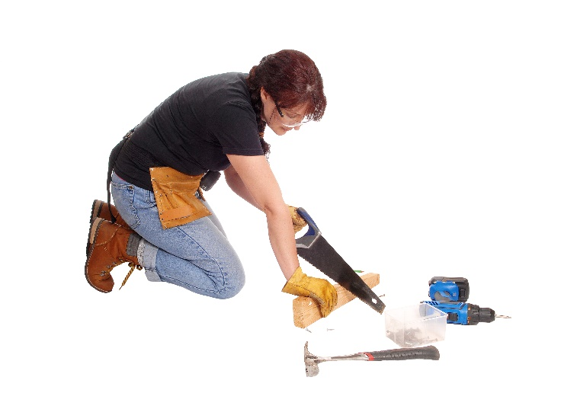
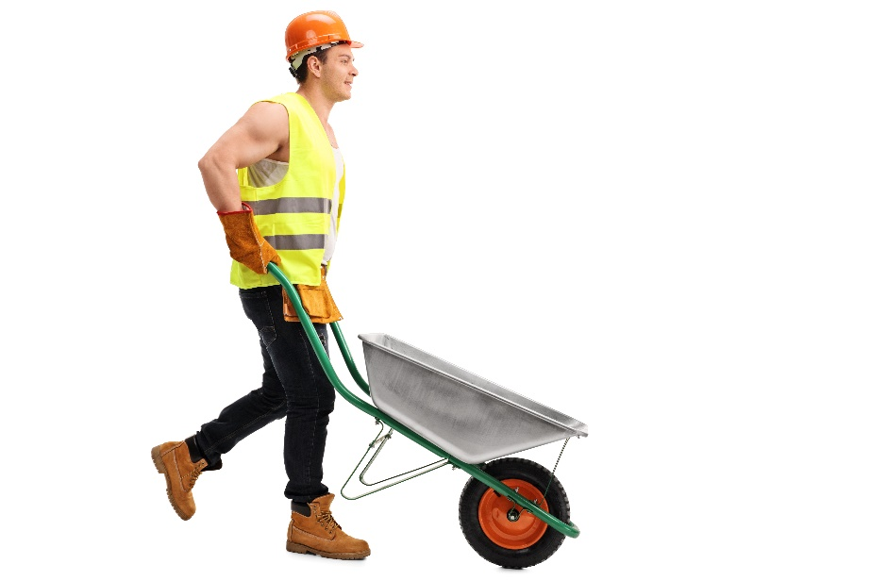
Non-living test
Does someone/something have to make it?
Does someone/something have to move it?
Was it once living, but not anymore?

Slide 13
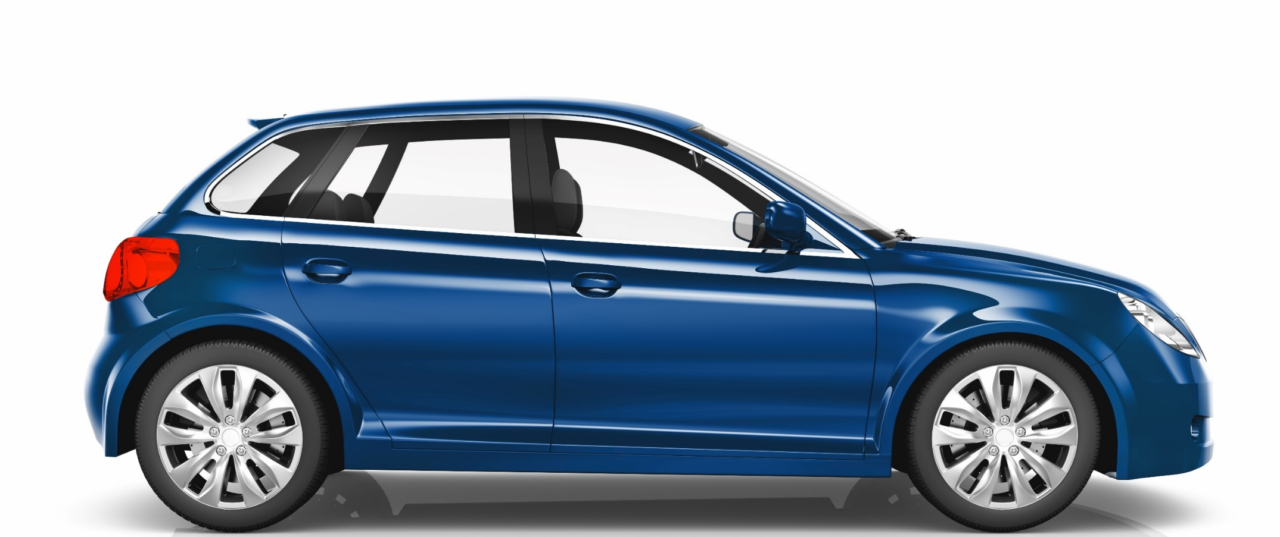
Dead or alive?

Slide 14
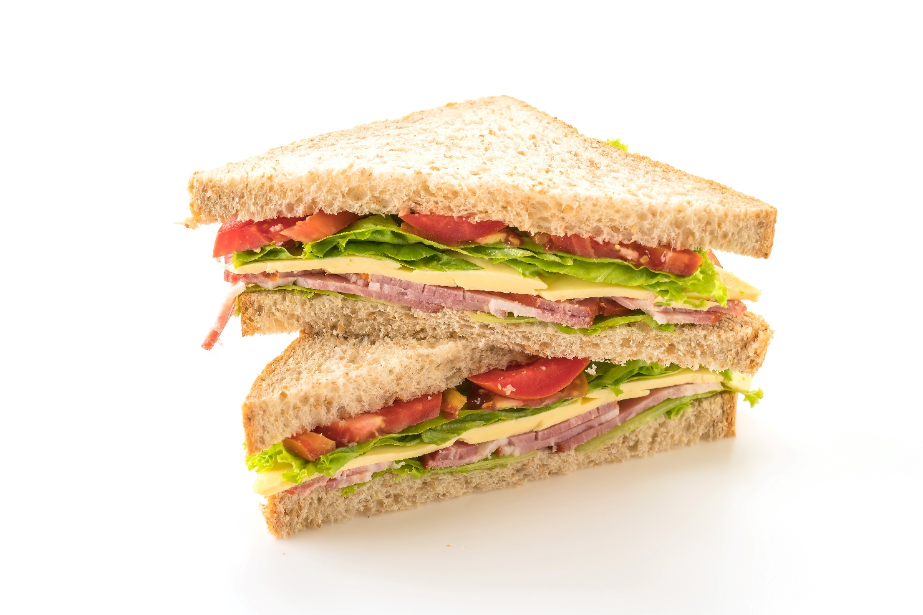
Dead or alive?

Slide 15
Dead or alive?

Slide 16
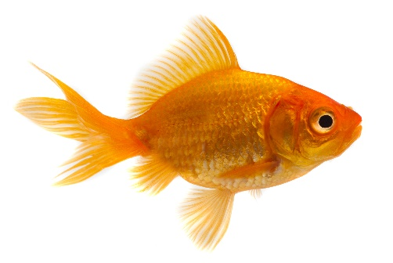
Dead or alive?

Slide 17
Create a list of objects you find around your school or classroom.
Split your page into two columns: ‘Dead’ and ‘Alive’. If you’re feeling clever, add a third for ‘Dead but used to be alive’.
Move the objects from your list into the correct column.
Dead but used to be alive
Dead
Alive
E.g:
Ruler
Me!
Pencil
Activity

Slide 18
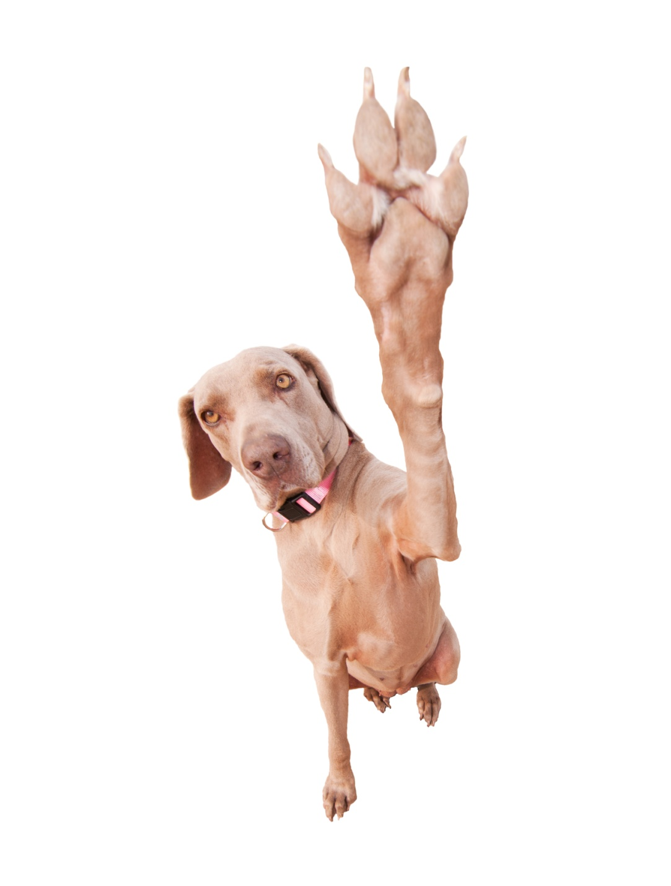
Thanks!

