Slide 1


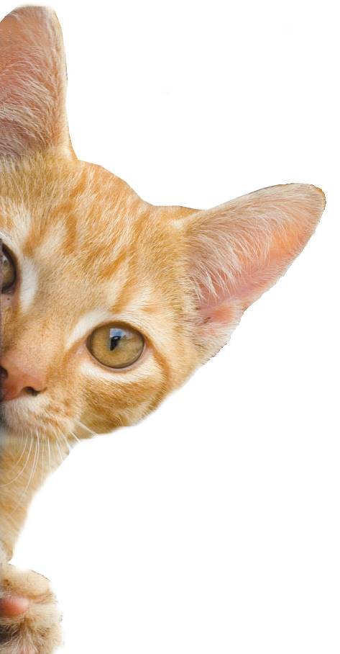
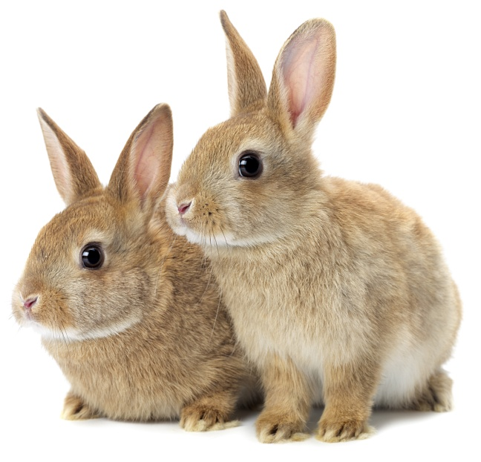
Body Parts
Notes:
Share:
Introduce the session and PDSA.
Tell children that PDSA treat the sick and injured pets of people in need...
Explain that PDSA is a special kind of vets, because they’re a charity. Discuss what a charity is and explain that PDSA looks after pets when owners can’t afford vet treatment.
Ask:
If they think it’s important to help sick and injured animals to get better?
What would happen to all the sick and injured pets PDSA treat if they weren’t around?
Share:
.
Tell them that today, you’re all going to learn about what pets need to be healthy and happy and also about some of the pets that PDSA has helped in their Pet Hospitals.

Slide 2
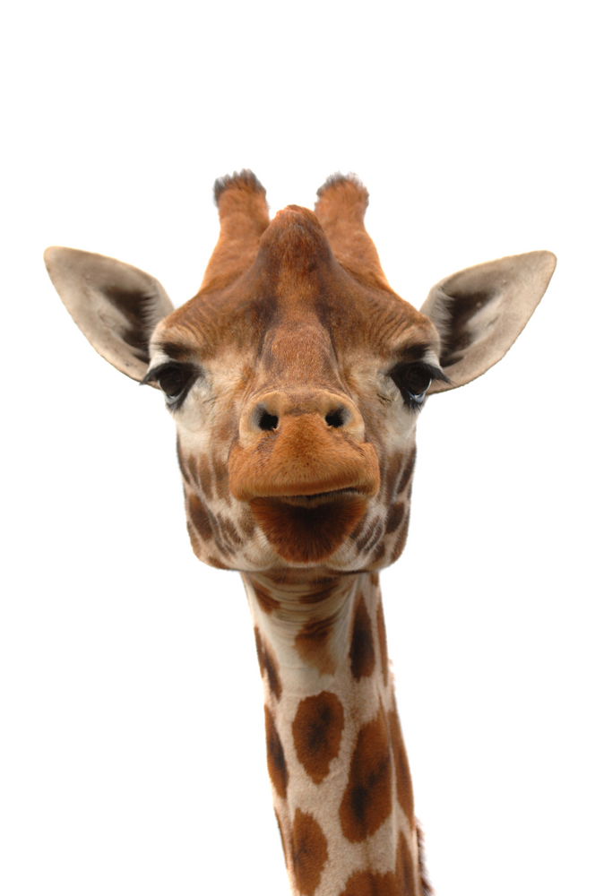
Can you tell what animal is shown just by looking at the close up?

Slide 3
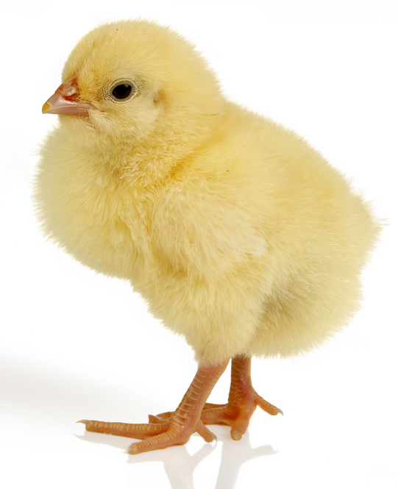

Slide 4
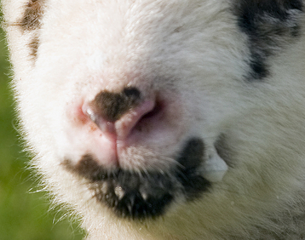


Slide 5



Slide 6
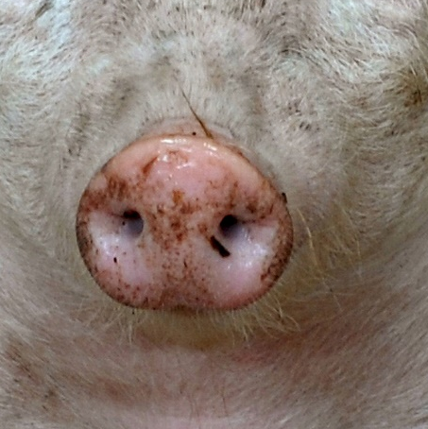


Slide 7
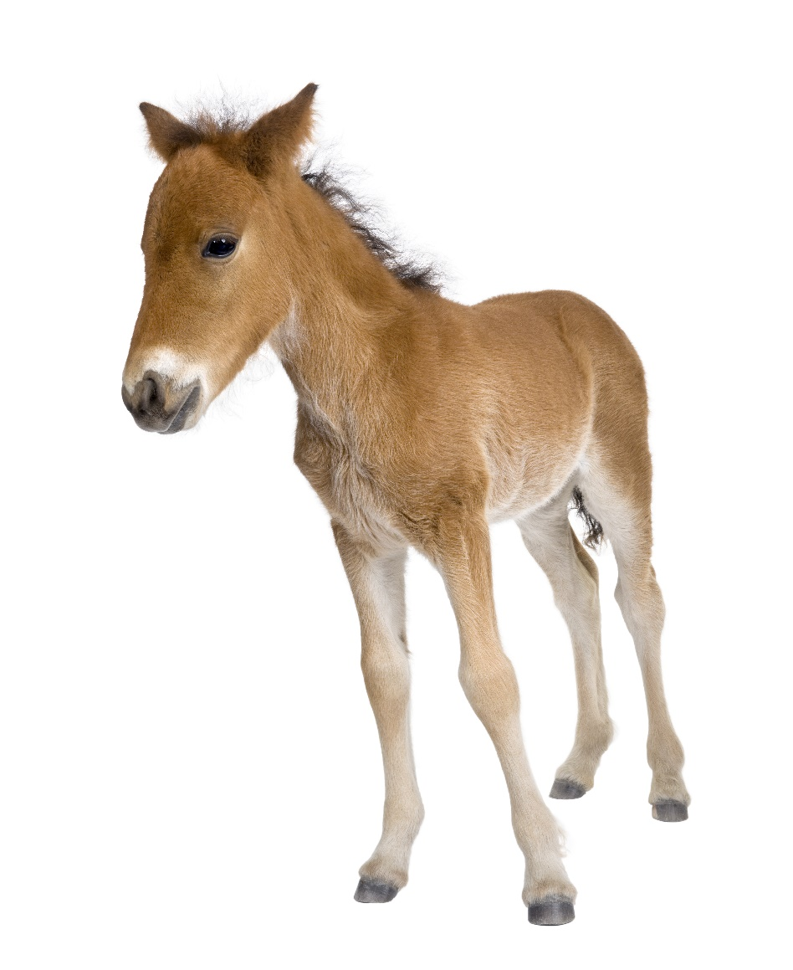

Slide 8
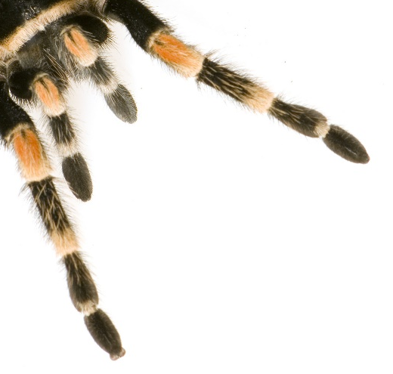


Slide 9
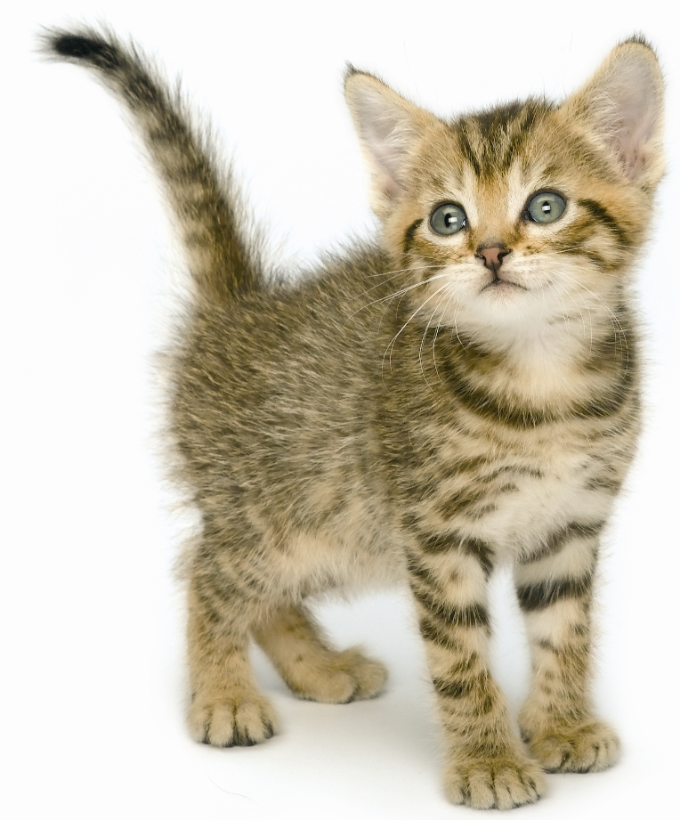


Slide 10
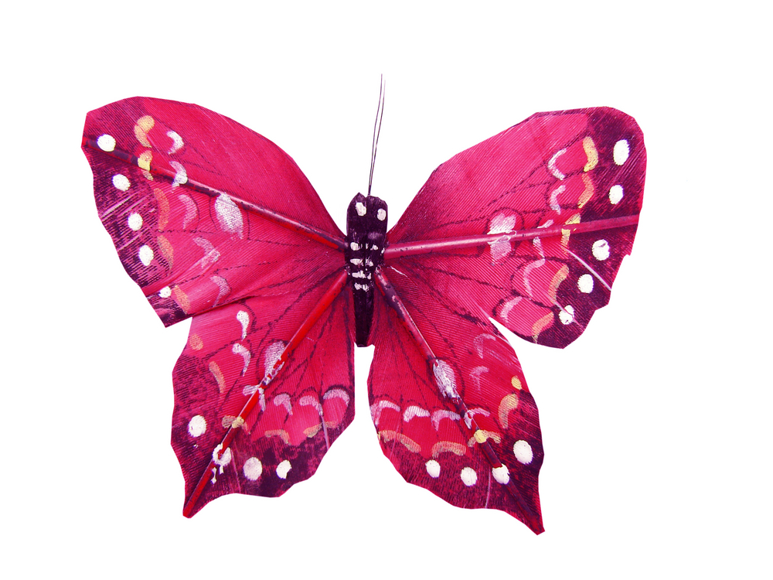

Slide 11
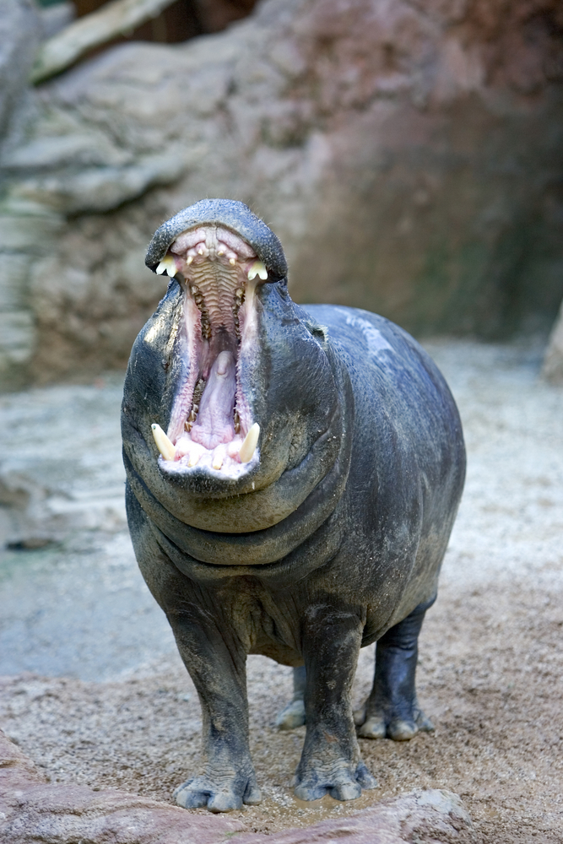

Slide 12



Slide 13


Learning Objectives
I will learn how to identify, name and label the basic parts of the body.
I will learn which body parts are related to each of the five senses.
I will learn how to describe different animals using their body parts.
Learning Outcomes
P
I can name the 5 senses and identify the body parts used.
I can describe a variety of animals using interesting adjectives.
I can label a variety of animals.

Slide 14
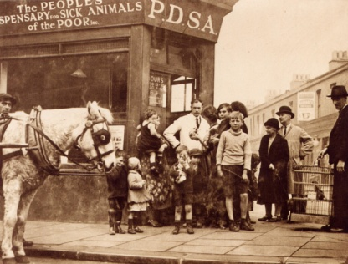

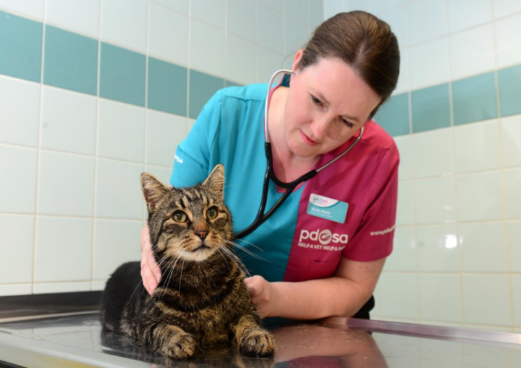
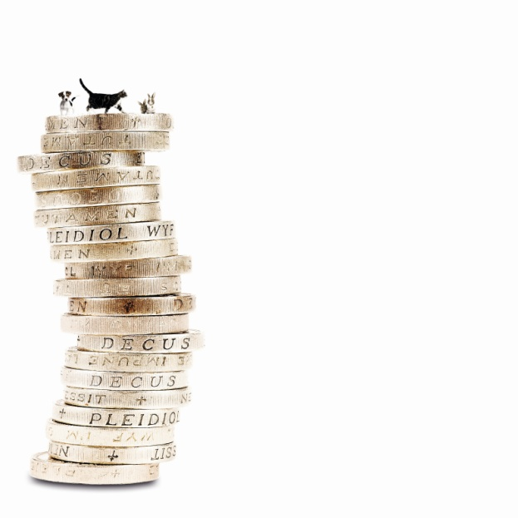
The UK’s leading vet charity …
PDSA is a 100 year old charity who have been treating sick and injured pets since 1917
They have Pet Hospitals all over the UK
They help one sick or injured pet every 5 seconds!
It costs the charity more than
£1 million every week to do their work
Notes:
Share the details on the slide and:
Tell children that PDSA treat the sick and injured pets of people in need..
Ask them if they think it’s important to help sick and injured animals to get better.
Explain that PDSA is a special kind of vets, because they’re a charity. Ask them what a charity does and explain that PDSA looks after pets when owners can’t afford vet treatment.
Ask them what would happen to all the sick and injured pets PDSA treat if they weren’t around.

Slide 15





A HOME
FRIENDS
HEALTH
FOOD & WATER
EXERCISE & FUN
What do pets need?…
Notes:
All pets, whether they’re large or small, need the same five things to keep them healthy and happy:
The right kind of safe, warm home with lots of space
The right kind of food and 24 hour access to fresh water
Exercise and fun (the chance to show normal behaviour)
Friends (This can be other animals, people, or both)
Health ( We all need to make sure our pets are kept healthy and take them to the vet when they’re not well)
Ask whose responsibility it is to keep pets healthy and happy and confirm that owners are responsible for looking after their pet properly.

Slide 16
https://www.youtube.com/watch?v=YssjnD8ohrU
Notes:
PDSA’s latest TV advert

Slide 17

Eye
Nose
Mouth
Hand
Knee

Slide 18

H_ND
A
E
_AR
N0_E
S
Y
E_E
TON_UE
G
Notes:
Relate the images to the senses – e.g. what sense does a nose relate to - smell

Slide 19
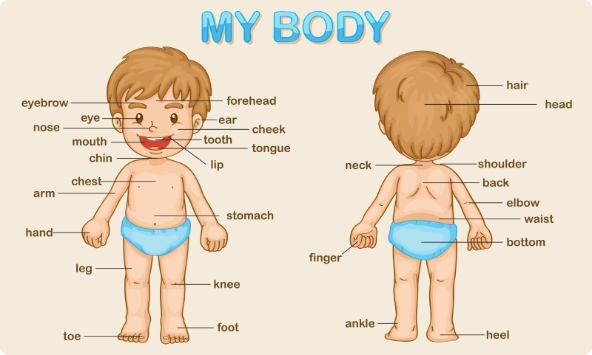

Slide 20
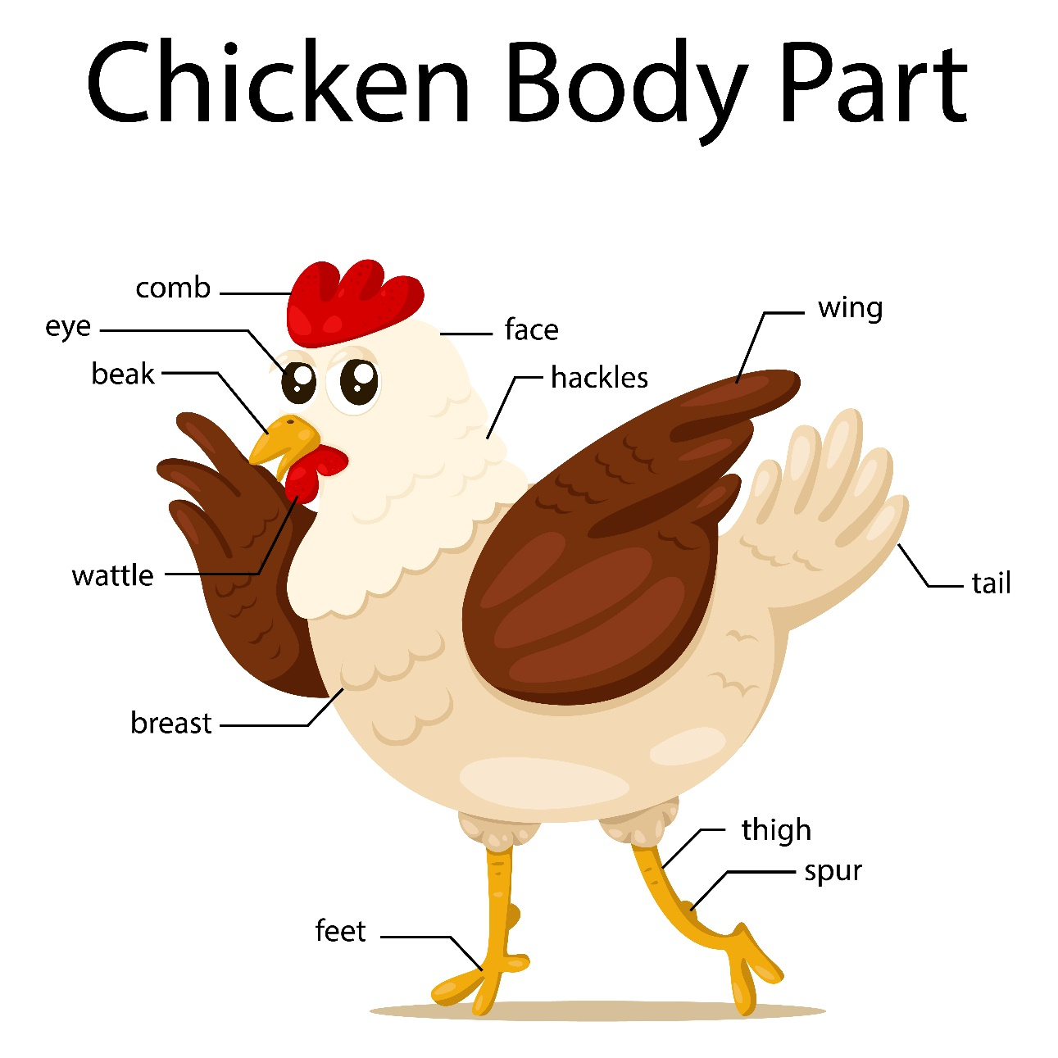
The chicken has ________ feet.
Notes:
Ask the pupils to fill in the blanks (hands up or on whiteboards)
Ask the pupils to complete the sentence with a describing word.

Slide 21
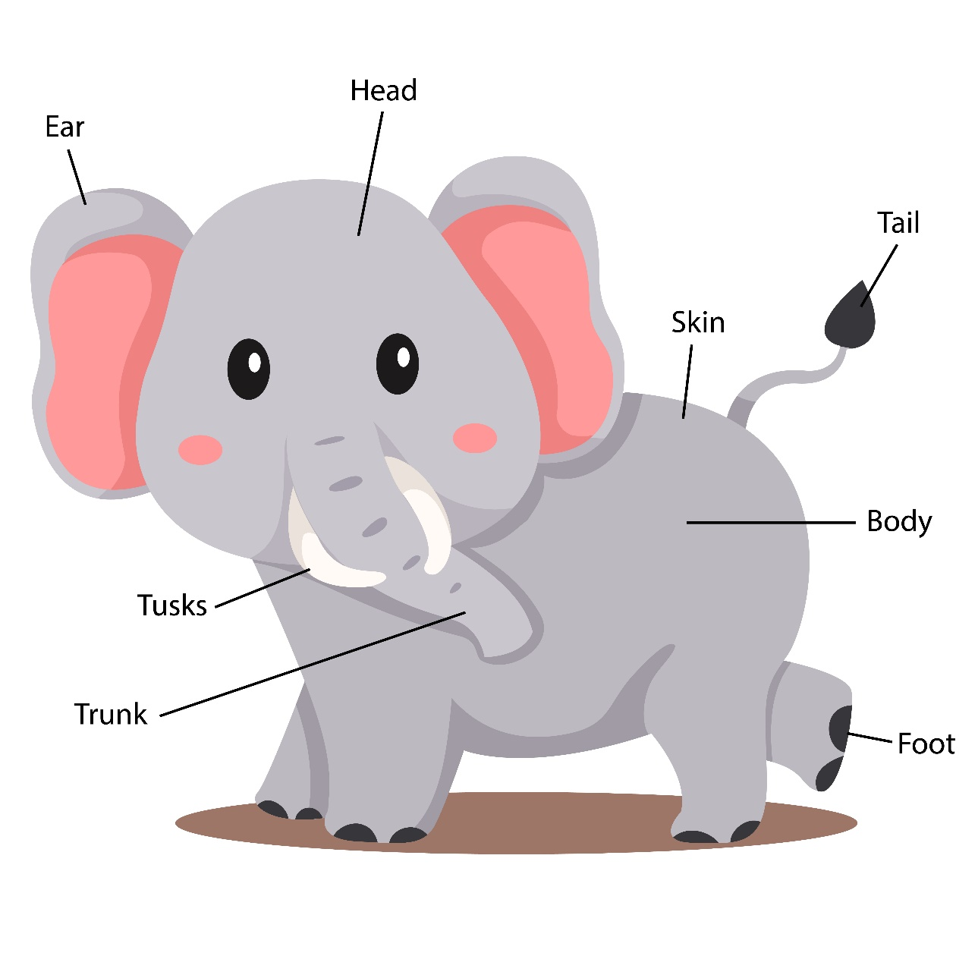
The elephant has ________ ears.
Notes:
Ask the pupils to fill in the blanks (hands up or on whiteboards)
Ask the pupils to complete the sentence with a describing word.

Slide 22
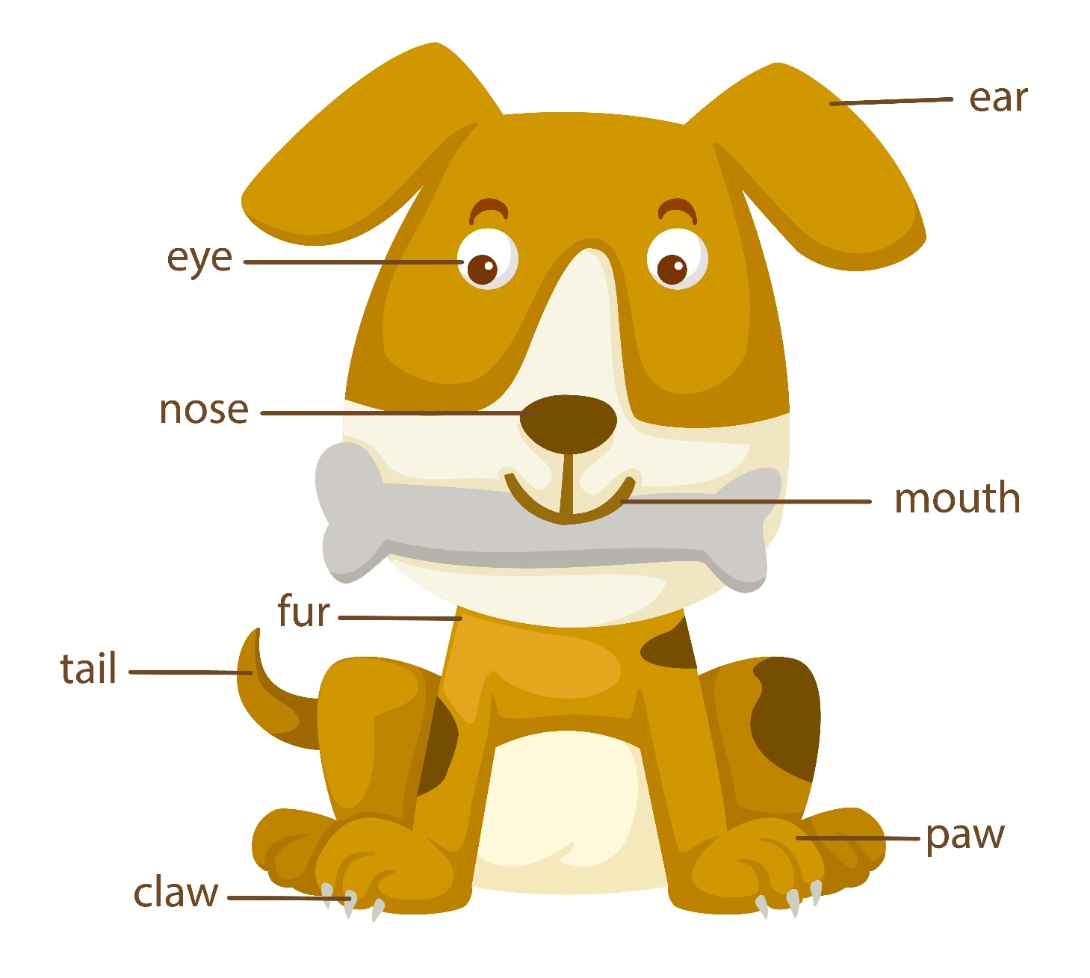
The dog has a ________ tail and _______ claws.
Notes:
Ask the pupils to fill in the blanks (hands up or on whiteboards)
Ask the pupils to complete the sentence with describing words.

Slide 23
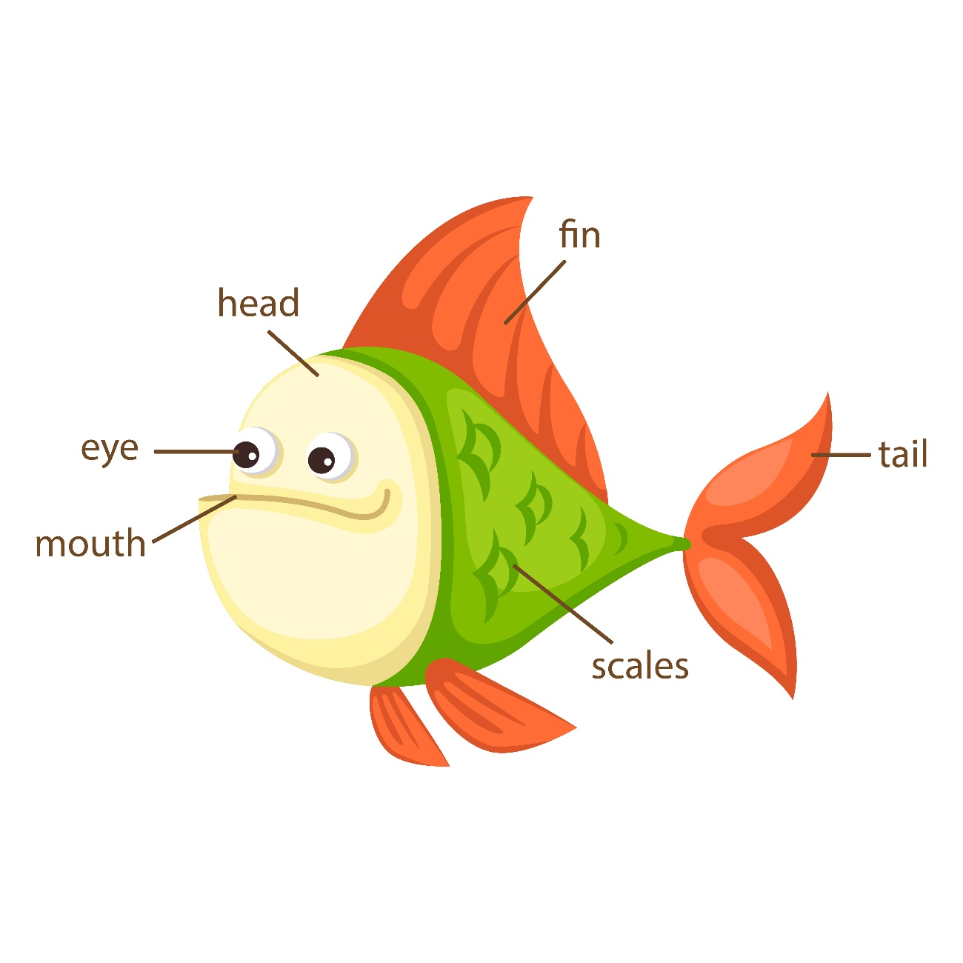
The fish has ________ eyes, _______ fins and a _______ tail.
Notes:
Ask the pupils to fill in the blanks (hands up or on whiteboards)
Ask the pupils to complete the sentence with describing words.

Slide 24
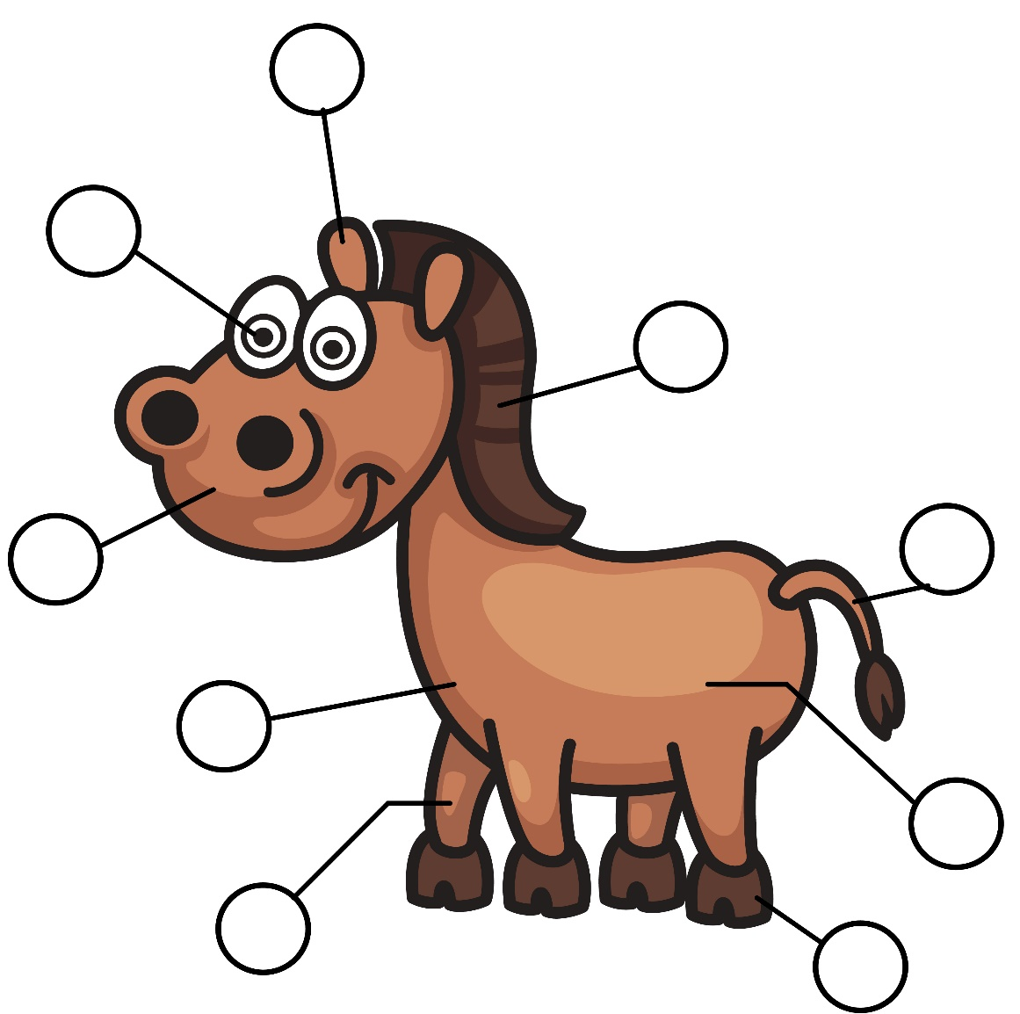

1
2
8
7
9
3
6
4
5
Notes:
Print this page (without answers) and ask the pupils to label the horse.
Once they’ve finished, the pupils can write a sentence about the horse.
Run through the answers as a class.

Slide 25
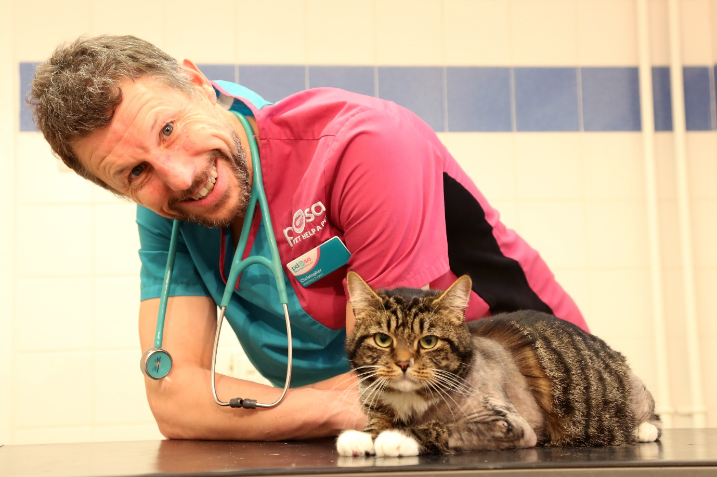
Perci
Notes:
Name:
Perci
Species:
Feline
Breed:
Domestic Short-haired
Colour
Tabby
PDSA Vet :
Chris Sherwood
What happened?
Perci, the two year old tabby cat was rushed to PDSA’s Leicester Pet Hospital for emergency treatment, when he suffered life-threatening injuries after being hit by a car outside his house.
Action taken:
Perci’s injuries were so severe that his owners were warned he may not survive the night. He was given medicine and was treated for shock and made comfortable, before he could be x-rayed. His x-ray showed that he had broken three of his four legs!
Vet’s comment:
‘Perci suffered terrible injuries in the road accident - it’s rare for a cat to break as many as three legs. Although his injury means he might never be able to use his right back leg fully again, he’s a real fighter and has lots more life in him yet. We’re so pleased he’s making such a brilliant recovery.”
Owner’s comment:
“I’m so grateful to the vets and nurses at the Pet Hospital in Leicester who did everything they could to save Perci. I wanted to give something back, so I set up a fundraising page to help raise money for Perci’s life-saving treatment. With the support of friends and family, we collected an amazing £1,300 for PDSA. I feel really happy that this will help other sick and injured pets, like Perci, who are in need of vet treatment.

Slide 26
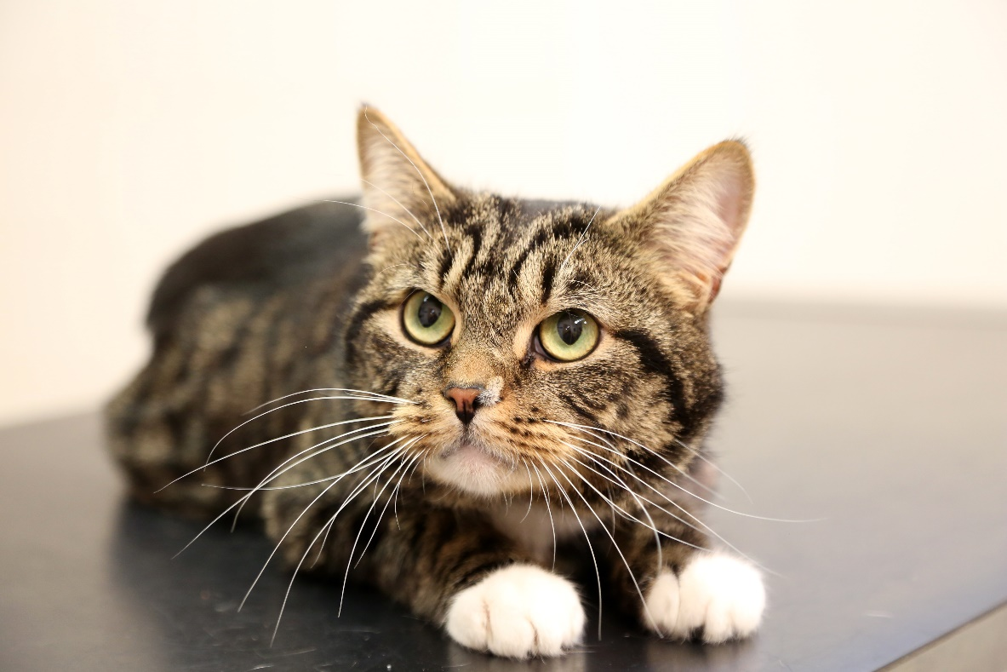
Saved thanks to PDSA!
Perci

Slide 27


Thanks!

