Slide 1
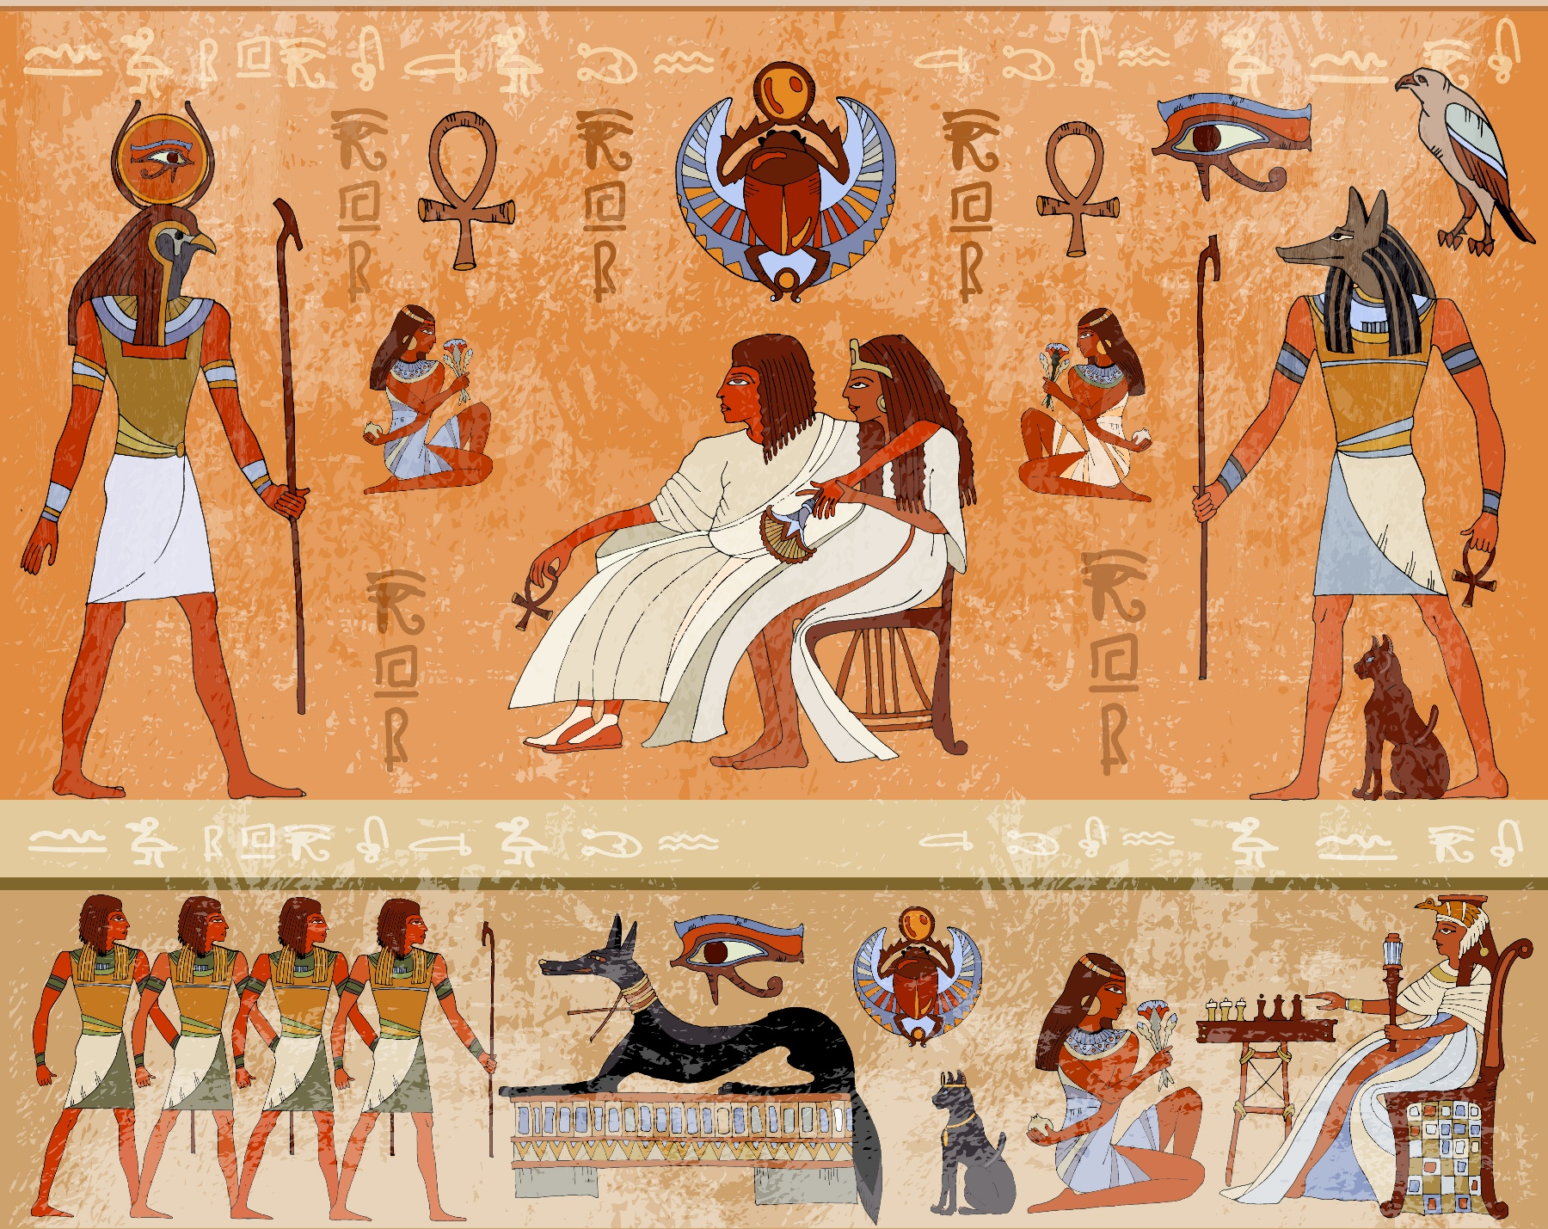
The Egyptians and their Pets
Notes:
It is often thought that the Egyptians worshipped animals as gods but we cannot be 100% sure. What we can be sure about is that domestic pets, like cat and dogs, were just as popular and loved by the people of Ancient Egypt as they are today. We know this because they depicted household pets in pictures like the one on this slide.

Slide 2


Learning Objectives
I will learn about the Ancient Egyptians and the pets they kept.
I will learn how to create an Egyptian mural using hieroglyphics.
Learning Outcomes
P
I can recall facts about cats and dogs in Ancient Egypt.
I can create a mural based on examples from Ancient Egypt.
I can accurately write my name using Egyptian hieroglyphics.

Slide 3
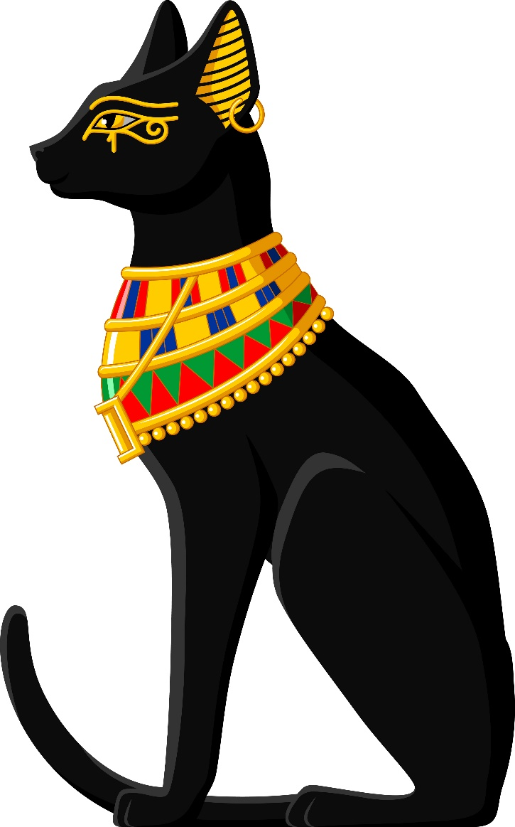
Cats
Cats were the most popular pet in Ancient Egypt.
Most households had at least one cat.
Cats were considered magical and would bring people luck as well as protecting people’s homes from rats.
A cat’s life was considered more important than their human master’s life.
If you hurt a cat you would be punished with the death penalty.
Notes:
Cats were by far the most popular pet in these times. Most households had at least one pet cat. This was mainly because they were associated with a goddess called Bastet, but also because of their practicality – they could take care of themselves, unlike dogs, and removed pests such as rats. They were also considered to be magical and would protect people’s homes and bring them good luck.
There is little evidence to suggest cats were given names.
A cat’s life was honoured higher than that of a human being and when in the face of danger, such as a house fire, the cat would be rescued first. What’s more, if you killed a cat, even by accident, you would be executed.

Slide 4
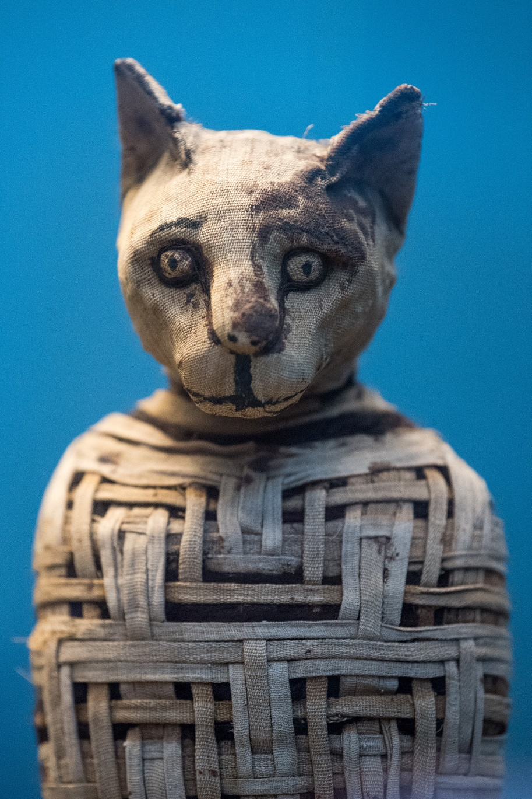
Mummification
The Ancient Egyptians believed the afterlife would be a continuation of their life on Earth.
They thought they could take their belongings with them to the next life and buried them alongside the bodies in tombs.
This included pets. They preserved their bodies by embalming them and wrapping them in cloth.
They also preserved fish for the afterlife so they’d have food.
Notes:
The Ancient Egyptians believed the next world (after death) would be a continuation of their current life and you could take certain things with you. It was because of this that they often mummified their pets and buried them with their owners in their tombs.
Mummification is where a body is preserved (kept fresh) by embalming it and wrapping it in cloth.

Slide 5
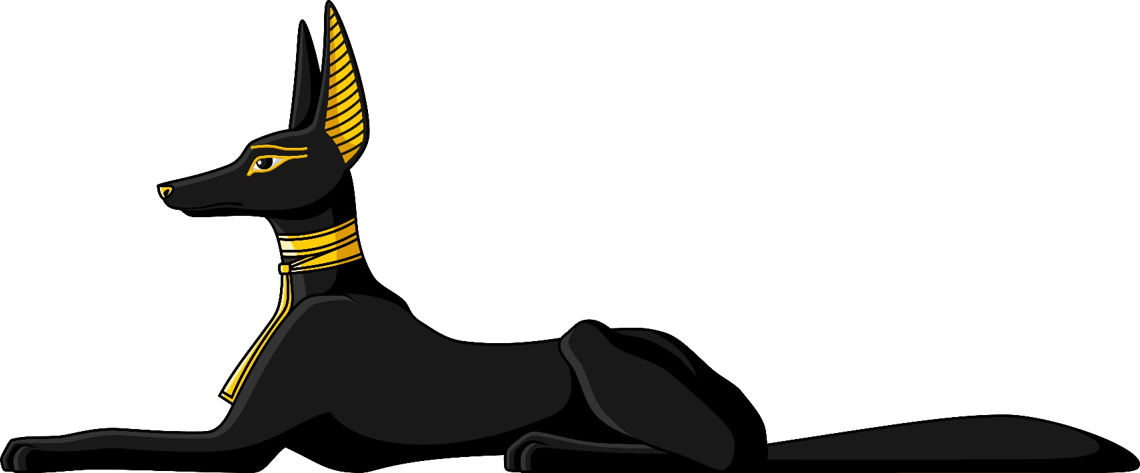
Dogs
Dogs were often owned by wealthy people as they needed a lot more care and attention than cats.
Dogs played an important part in hunting.
They were given names just like dogs today.
It is believed that the Ancient Egyptians invented collars and leads.
To call someone a ‘dog’
was insulting.
Notes:
Dogs were often owned by the more wealthy upper class people as they required more care than owning a cat.
They were important to the Ancient Egyptians as they helped with hunting.
It is believed that the Egyptians first invented the dog collar as there are images that show dogs being walked on leashes.
Dogs were named, just as they are today. We know this because collars have been uncovered showing names such as ‘Brave one’ and even ‘Blacky’.
That being said, dog’s lives were still considered less important to that of a human being, unlike cats, and to call someone a ‘dog’ was an insult.

Slide 6
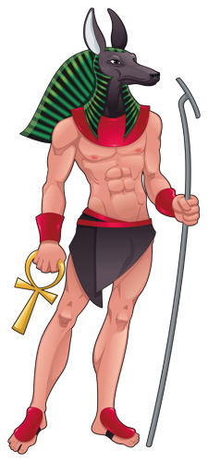
Anubis
Anubis was the god of embalming and the dead. It is believed that he watched over the dead and guided their souls to be judged.
He is usually drawn as a man with a canine head.
Pet dogs were either buried in the temple of Anubis to help them pass on to the afterlife or with their human masters.
Dogs were part of the family and when they died, their human masters would shave their own body hair as a mark of respect.
Notes:
Anubis, Egyptian god – guided the soul of the deceased to the Hall of Truth where the soul would be judged by another god called Osiris.
When pet dogs died they were given a large ceremony (like the funerals held for people today) and sometimes buried in the temple of Anubis to help them pass on to the afterlife and continue to enjoy their lives (and later meet up with their owners once again). In other cases they were buried with their owners as a sign of companionship. If their owners died before the dog, the dog would be killed and mummified to enable this to happen. They did this with their slaves too.
Dogs were seen as part of the family and in order to show grief, once they had passed, the humans in their family would shave off their body hair.

Slide 7
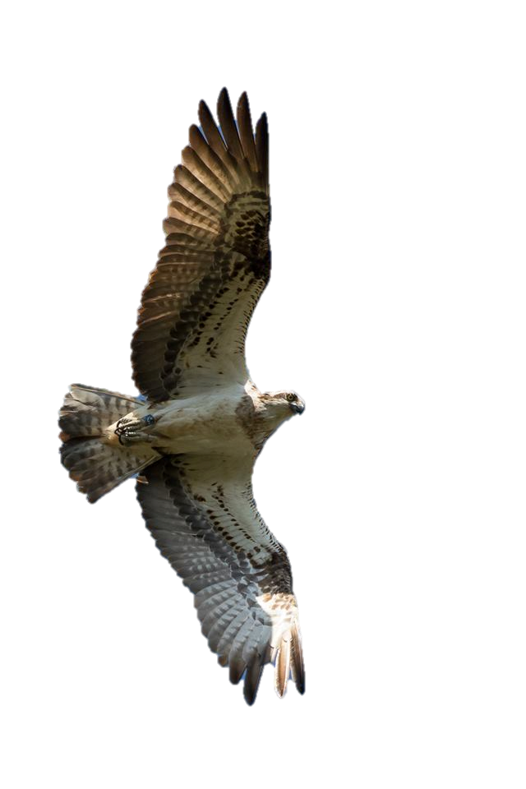
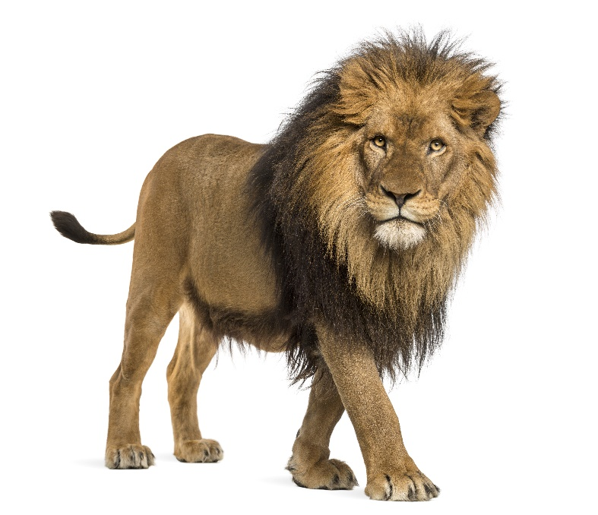
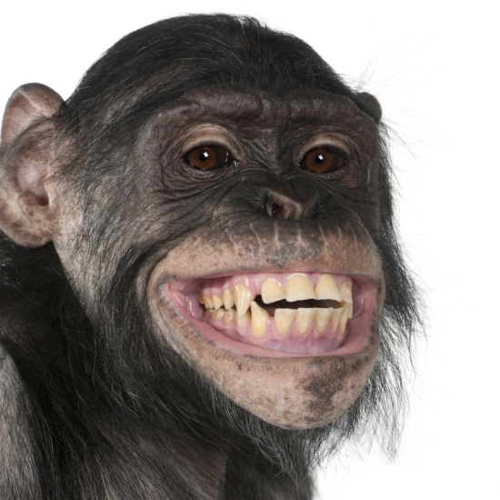
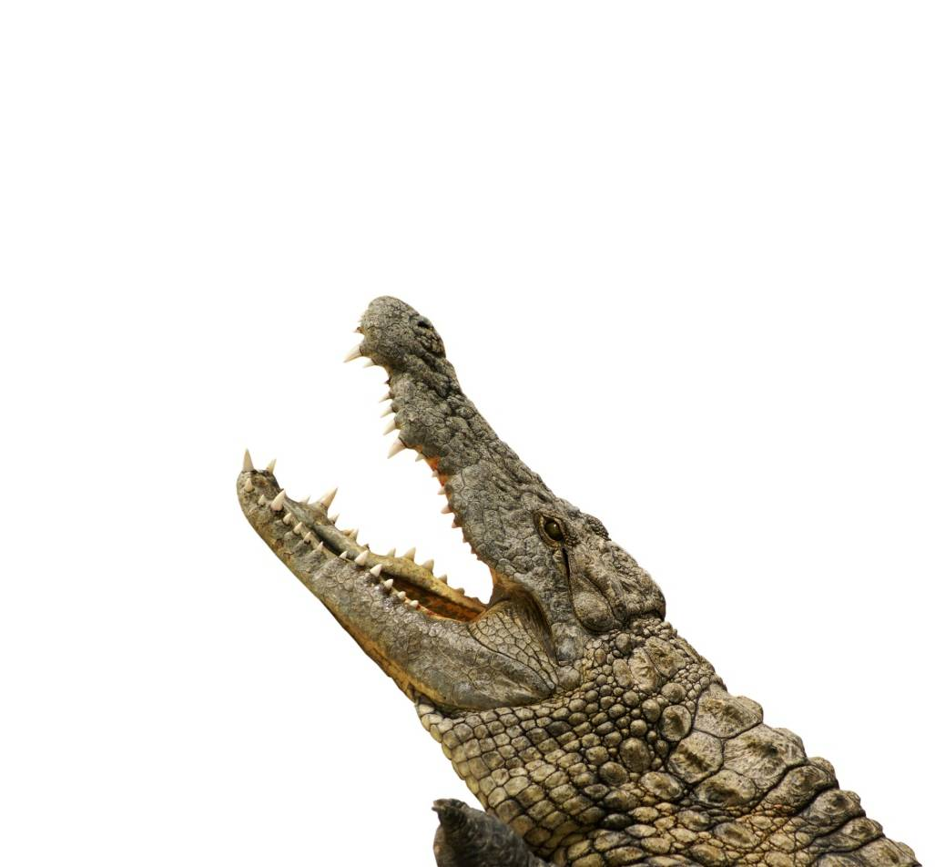
It wasn’t just cats and dogs that they kept as pets:
Notes:
Ask the pupils why we don’t keep these animals as pets today – too dangerous and we wouldn't be able to meet their needs.

Slide 8
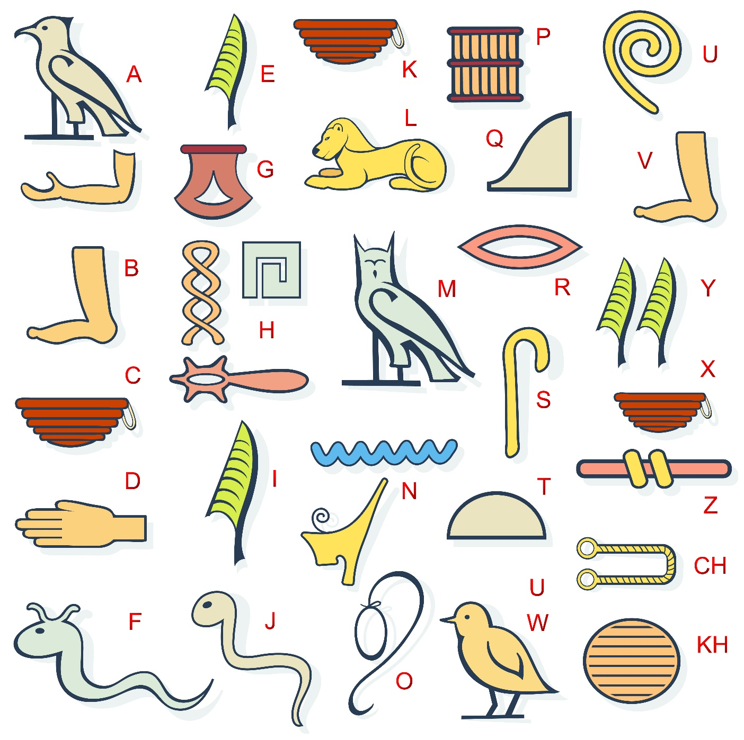
Activity 1
Notes:
This slide shows the Egyptian hieroglyphic alphabet.
The Ancient Egyptians used pictures to write and these were called hieroglyphics. This was a very complicated way of writing as they used thousands of symbols. Some of the symbols represented sounds, like our letters, and other's represented entire words. Also, hieroglyphics could be written in any direction - left to right, right to left, or top to bottom and they didn't use punctuation.
Ask the pupils to write their name using the alphabet on the slide.

Slide 9
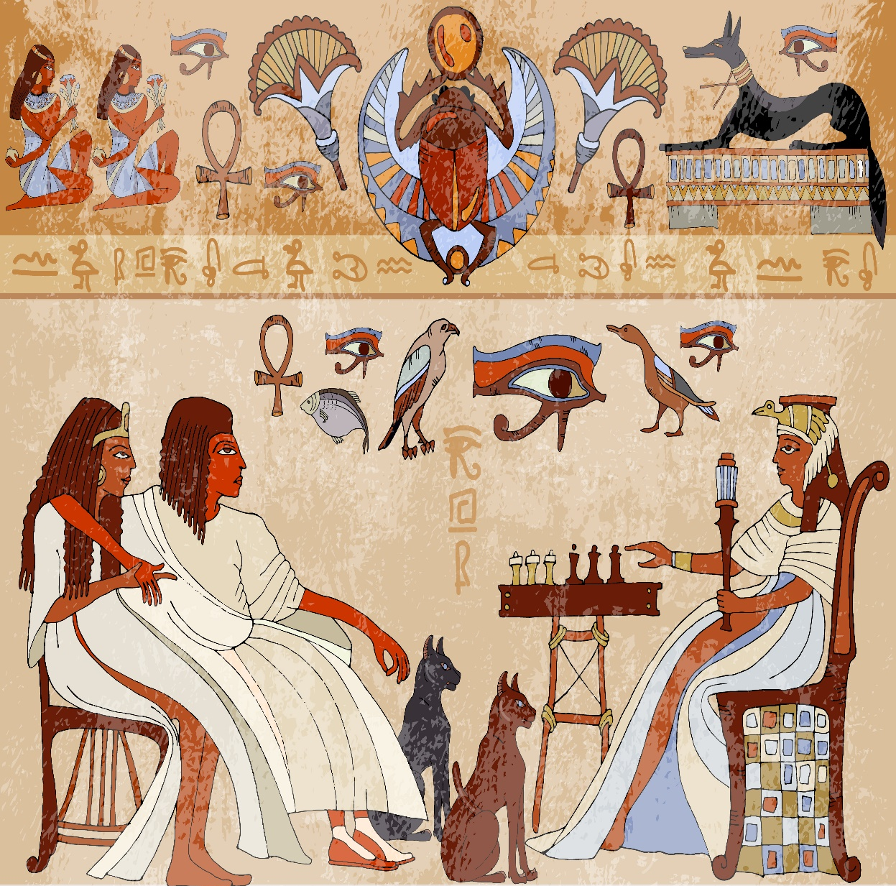
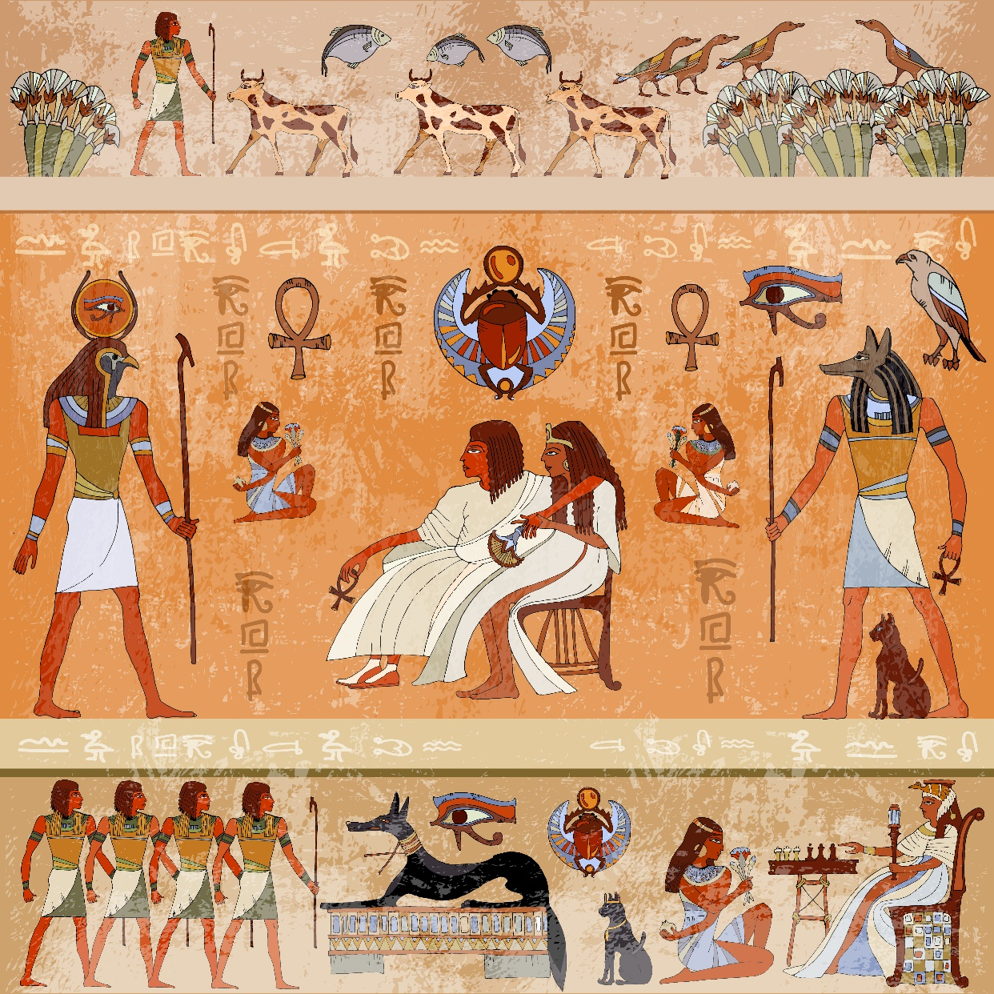
Activity 2
Notes:
Ancient Egyptian art included paintings, sculptures carved in wood or stone, ceramics, drawings on papyrus, jewellery and other art media. The images on the slide show some of their beautiful murals. The size of the people shows their importance – if one person is bigger than another, it shows they have a higher status.
The Ancient Egyptians often painted on tablets or walls (especially inside the temples), but they also painted on a type of paper called papyrus. This was made from a tall reed-like plant. They bound strips of the plant’s stem to make a single flat sheet to write on.
Give the pupils the task of creating their own mural based on their own families – not forgetting their pets!
You could make these look more authentic by using tea-stained paper (or even by obtaining real papyrus).
Higher ability pupils could research some further examples of hieroglyphics and what certain symbols mean.
Alternatively, if they’re creating their own symbols they could include a key.

Slide 10
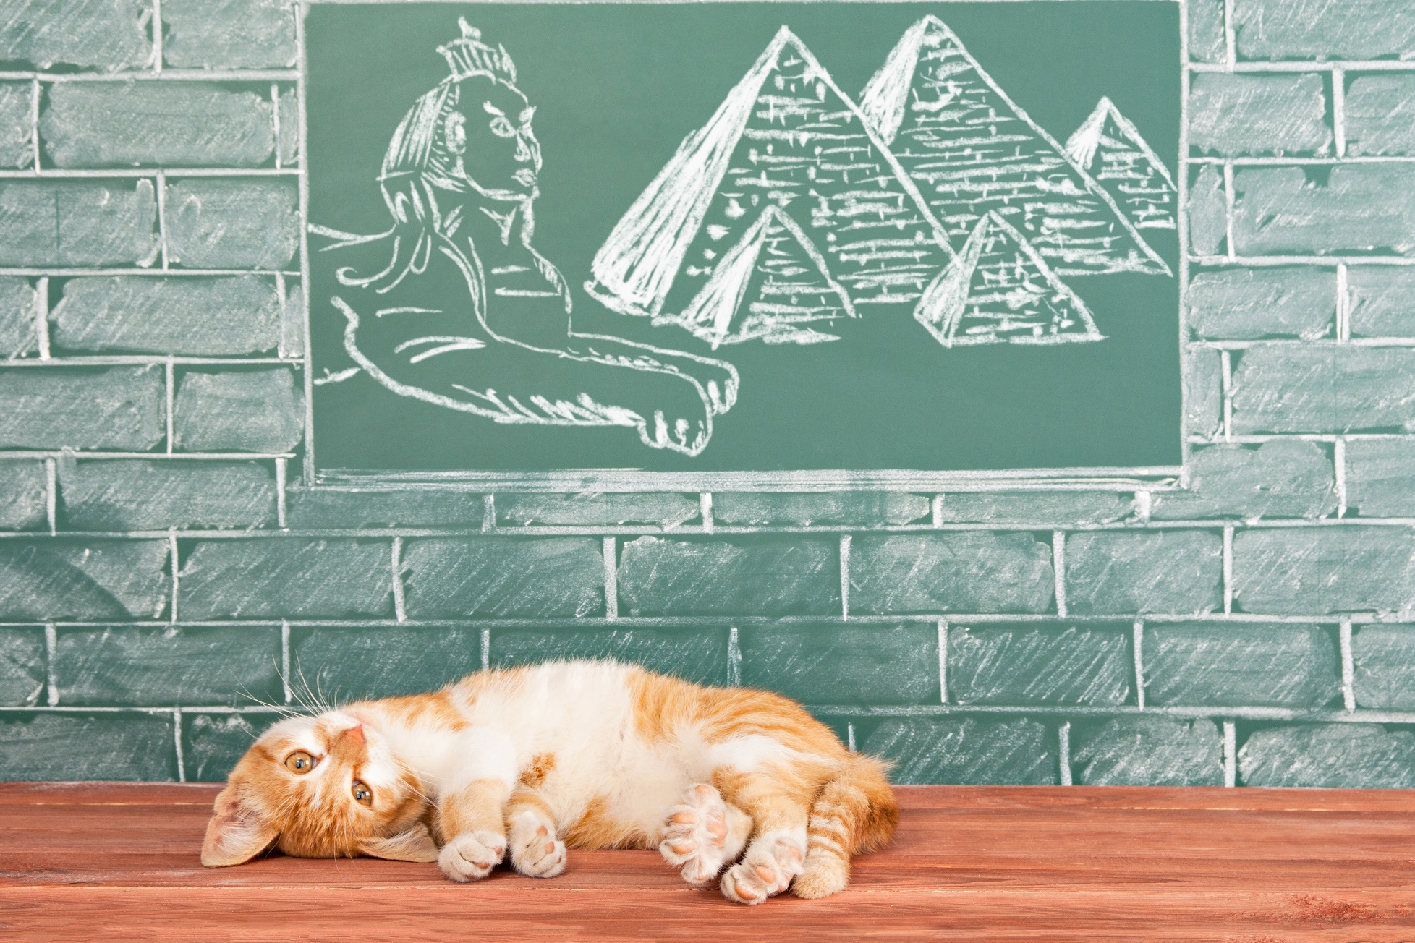
Thanks!
Notes:
Thanks from PDSA

