Slide 1


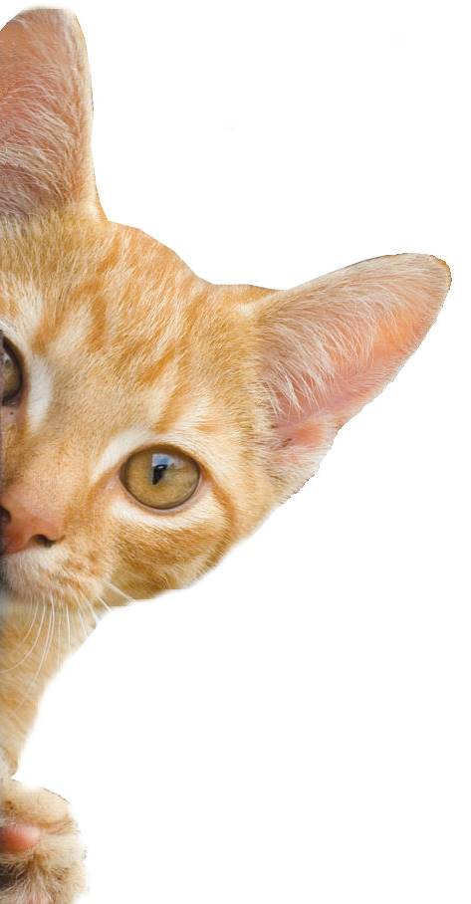
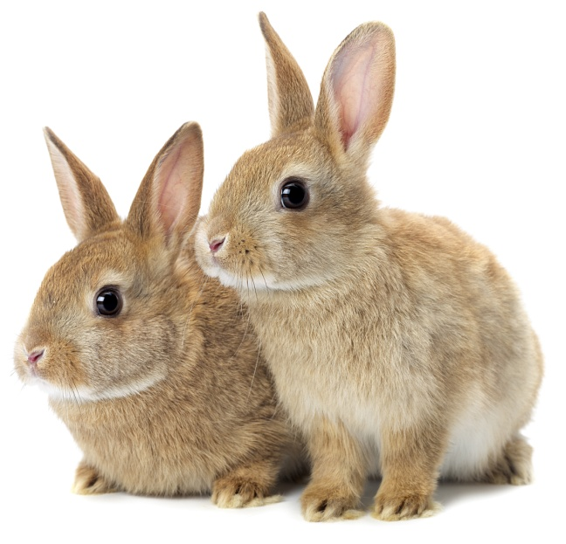
Wild Animals
Notes:
Share:
Introduce the session and PDSA.
Tell children that PDSA treat the sick and injured pets of people in need...
Explain that PDSA is a special kind of vets, because they’re a charity. Discuss what a charity is and explain that PDSA looks after pets when owners can’t afford vet treatment.
Ask:
If they think it’s important to help sick and injured animals to get better?
What would happen to all the sick and injured pets PDSA treat if they weren’t around?
Share:
Tell them that today, you’re all going to learn about what pets need to be healthy and happy and also about some of the pets that PDSA has helped in their Pet Hospitals.

Slide 2
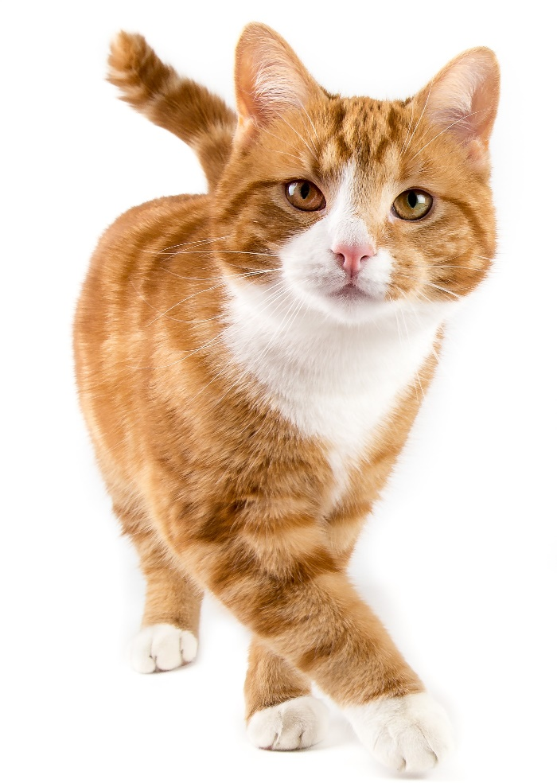
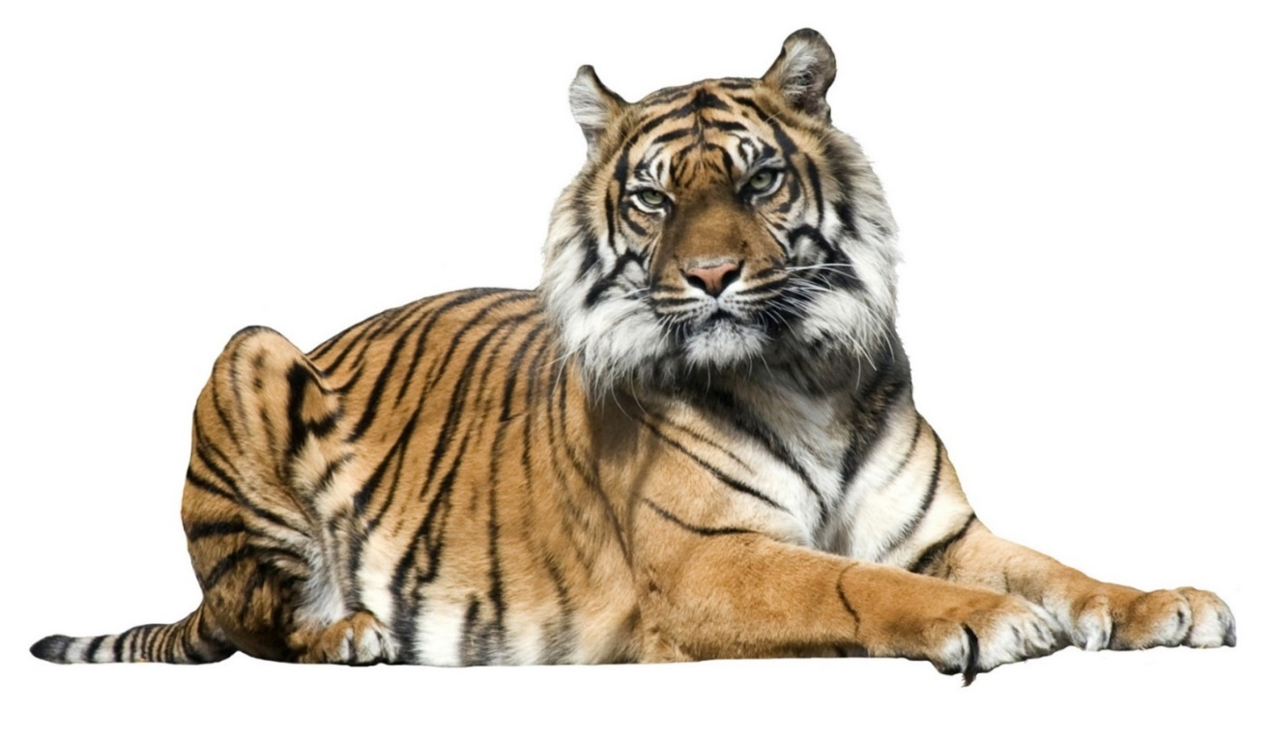
Wild at heart
Notes:
Ask the pupils to consider which is more important: a tiger in captivity or a cat without a home (stray)
Consider what each of these would need (e.g. home, food, etc.)

Slide 3





A HOME
FRIENDS
HEALTH
FOOD & WATER
EXERCISE & FUN
What do pets need?…
Notes:
All pets, whether they’re large or small, need the same five things to keep them healthy and happy:
The right kind of safe, warm home with lots of space
The right kind of food and 24 hour access to fresh water
Exercise and fun (the chance to show normal behaviour)
Friends (This can be other animals, people, or both)
Health ( We all need to make sure our pets are kept healthy and take them to the vet when they’re not well)
Ask whose responsibility it is to keep pets healthy and happy and confirm that owners are responsible for looking after their pet properly.

Slide 4
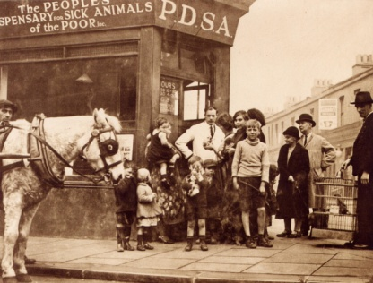

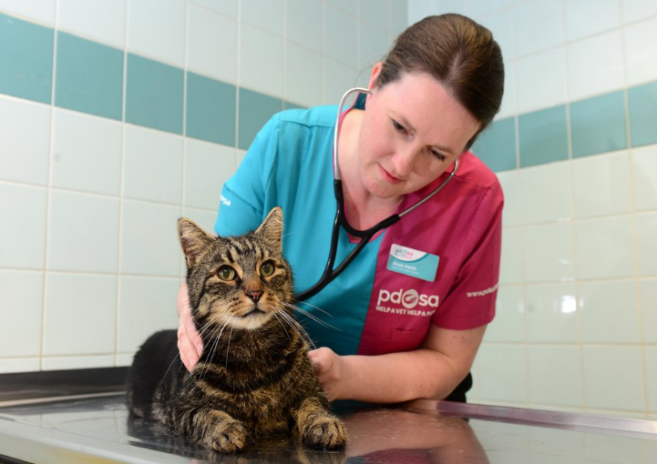
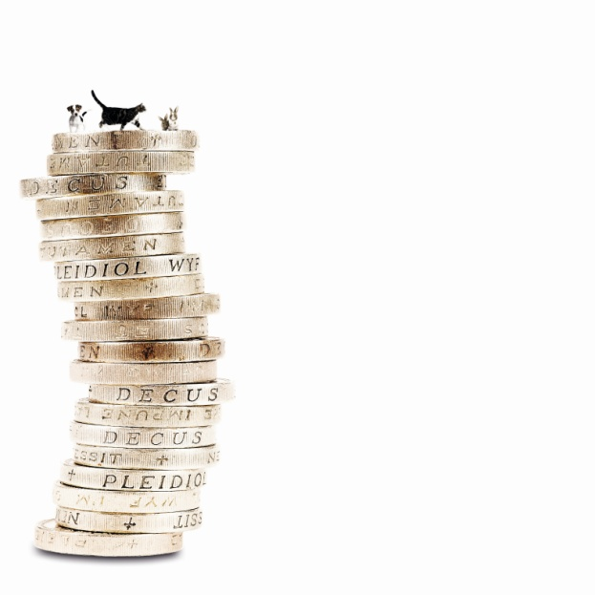
The UK’s leading vet charity …
PDSA is a 100 year old charity who have been treating sick and injured pets since 1917
They have Pet Hospitals all over the UK
They help one sick or injured pet every 5 seconds!
It costs the charity more than
£1 million every week to do their work
Notes:
Share the details on the slide and:
Tell children that PDSA treat the sick and injured pets of people in need..
Ask them if they think it’s important to help sick and injured animals to get better.
Explain that PDSA is a special kind of vets, because they’re a charity. Ask them what a charity does and explain that PDSA looks after pets when owners can’t afford vet treatment.
Ask them what would happen to all the sick and injured pets PDSA treat if they weren’t around.

Slide 5


Learning Objectives
To be able to define what is meant by the term habitat
To learn that animals require different things in their habitats
To explain why a habitat would be suitable or unsuitable for a particular animal
To recognise how a habitat meets the needs of an animal
Learning Outcomes
P
I can define what is meant by the term habitat.
I can describe an animal’s habitat.
I can explain why different animals need different habitats.

Slide 6
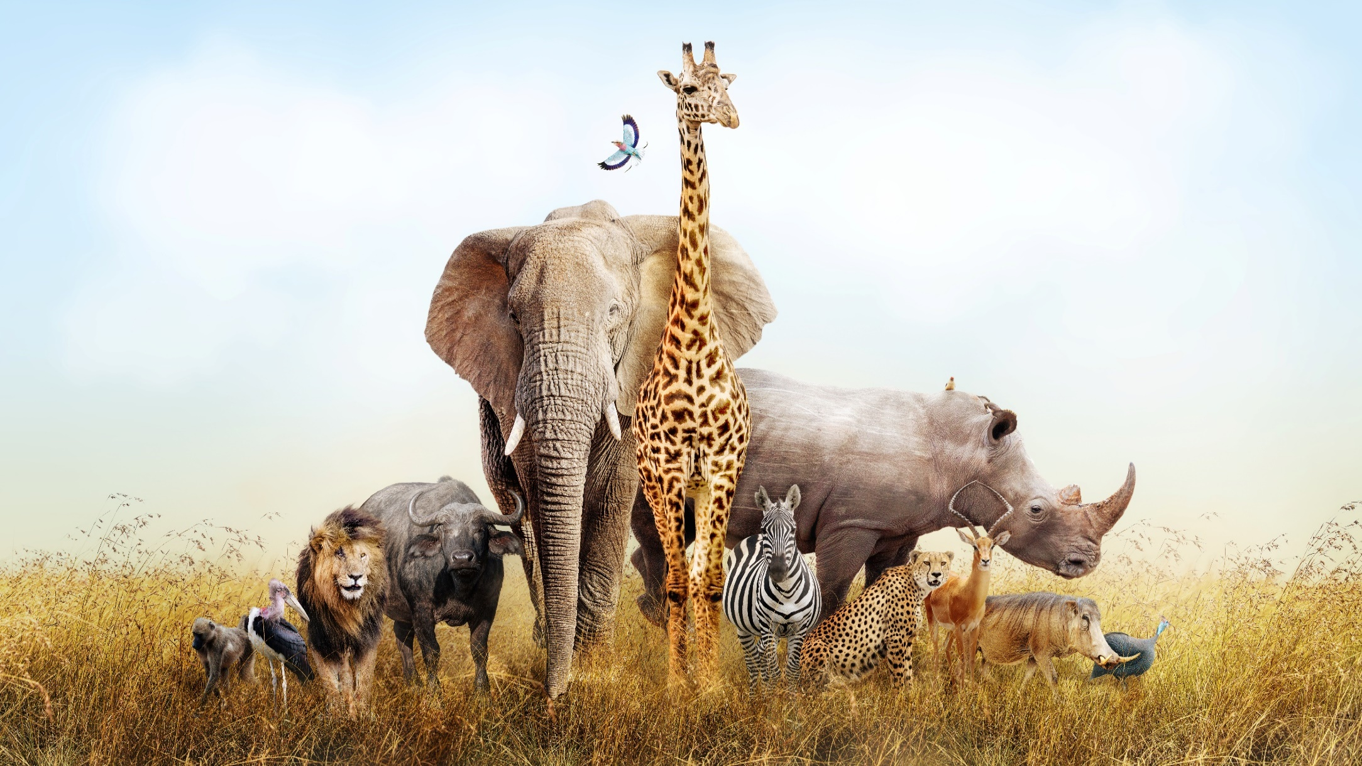
Habitats
What do animals need from their habitats?
Notes:
A habitat is a place that an animal or a plant lives. It provides the animal with food, water and shelter. There are many different sorts of habitats around the world from forests to grasslands and from mountain slopes to deserts.
Different habitats are home to different animals. They live well together because they all do things to help keep the whole habitat healthy and in balance.
Ask the pupils if they can think of an examples of habitats.

Slide 7
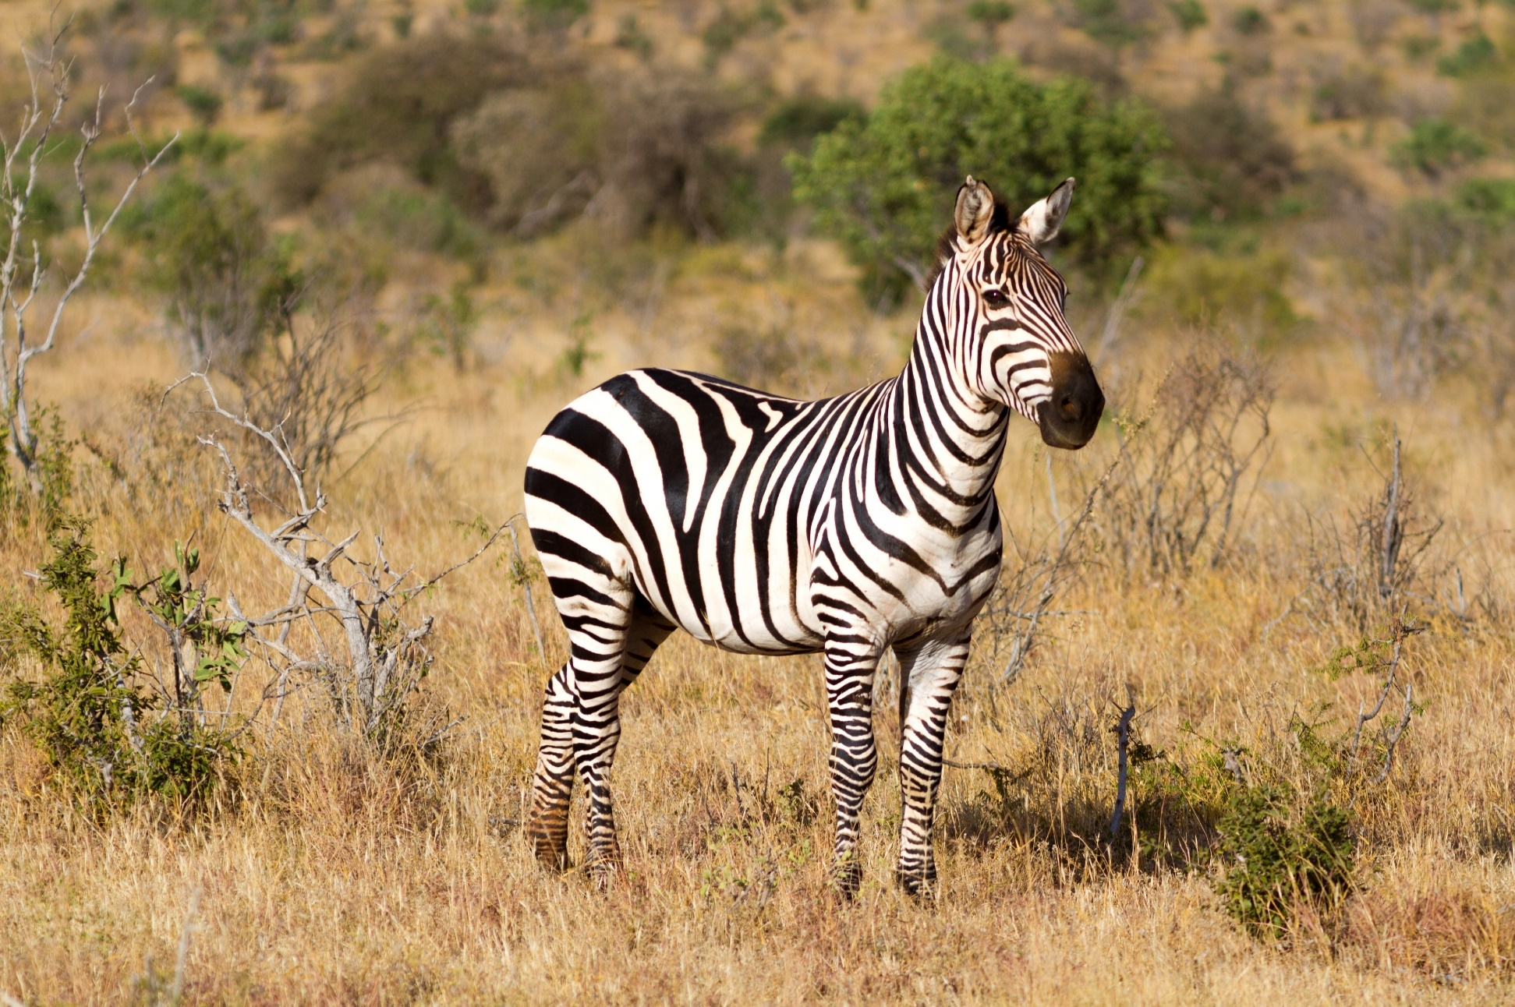
Grassland
Notes:
Grasslands are areas filled with tall growing grasses. Grasslands are too dry for many trees to grow. All the continents of the world except Antarctica contain some grassland.
No matter which continent, grasslands support a wide variety of animal life. Large numbers of birds, grazing mammals, reptiles, insects and predators live throughout the grasslands of the world.
Some of the animals that live in grasslands all over the world include:
Aardvark, Alpaca, Ant, Baboon, Badger, Bat, Bee, Bison, Buzzard, Cheetah, Cobra, Coyote, Fox, Rabbit and Zebra.

Slide 8
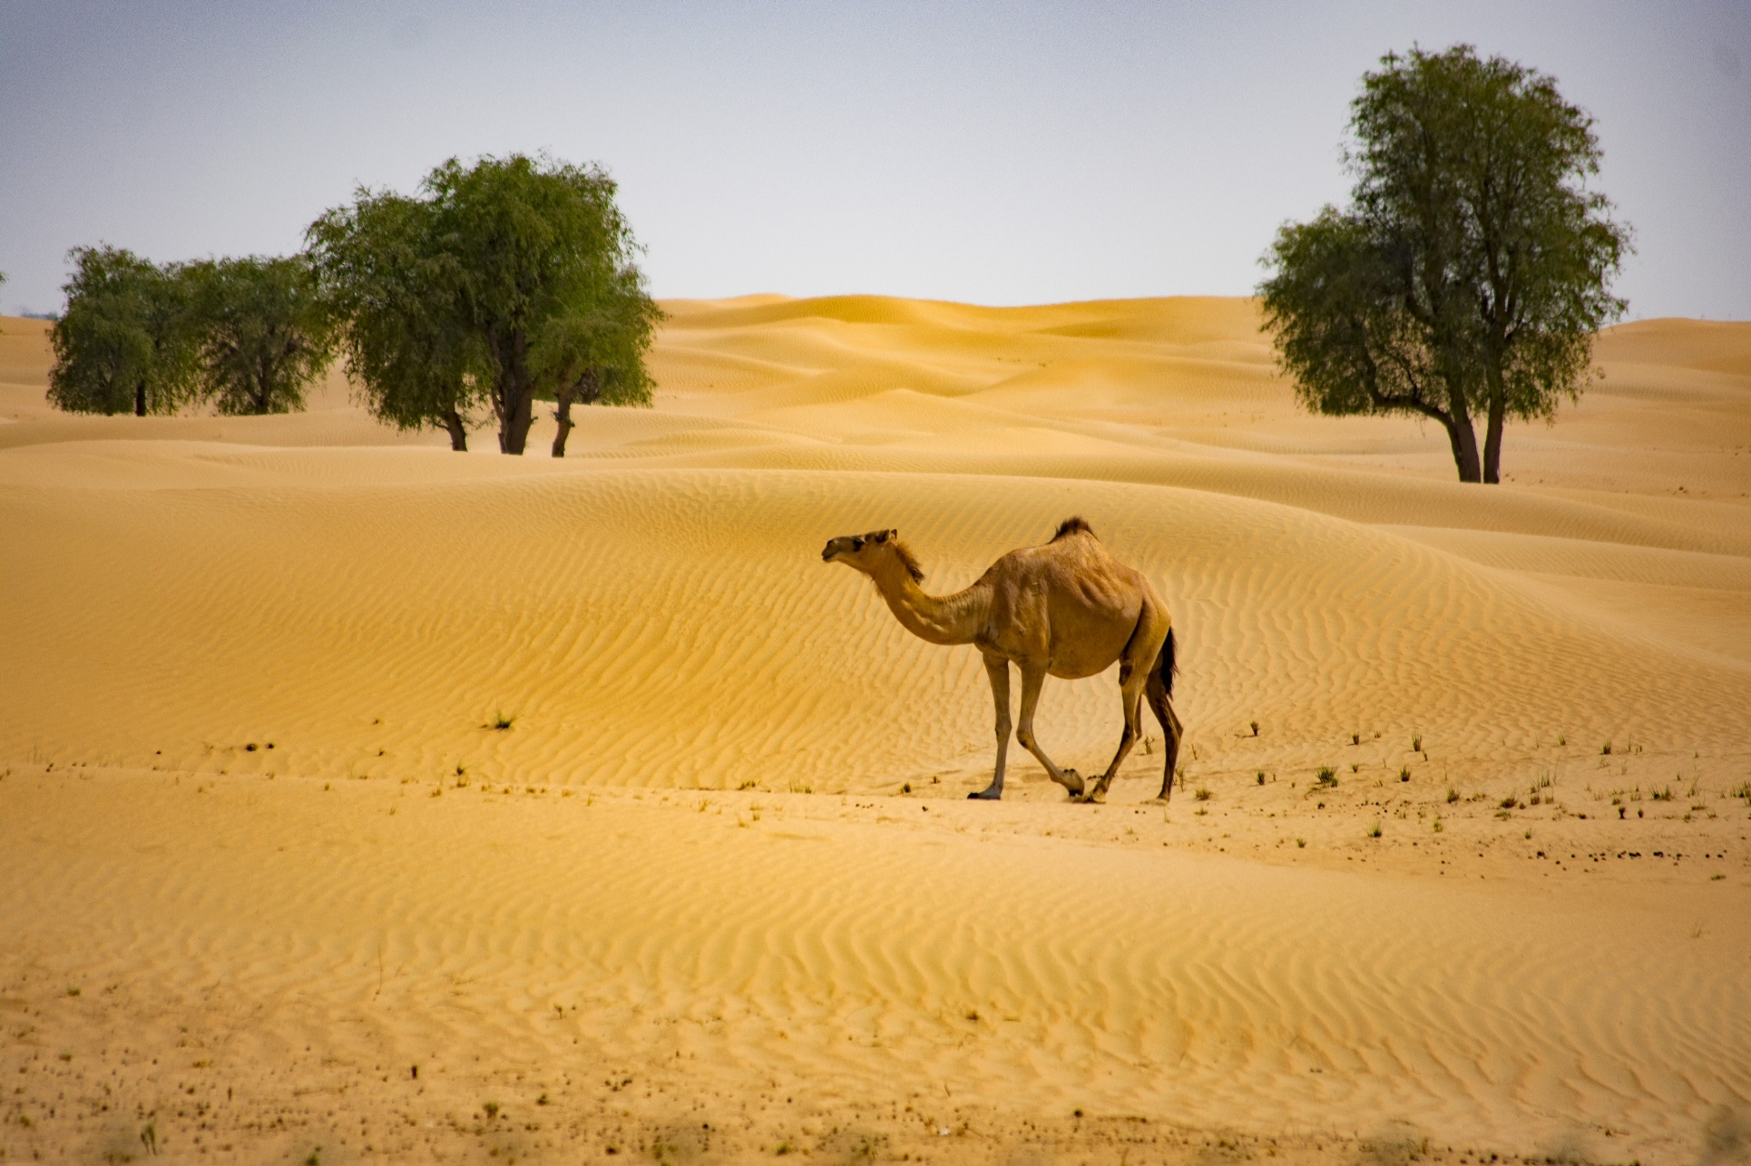
Desert
Notes:
Deserts are dry and have very few plants as they get less than 6 inches of rain per year.
Deserts are not easy places for animals to live. Animals who live in them often have special features that help them survive.
Some of the animals that live in the desert include:
Camel, Cheetah, Chipmunk, Elephant, Eagle, Gecko, Hyena, Leopard, Lion, Macaw, Meerkat, Ostrich, Sand Cat, and Tortoise.

Slide 9
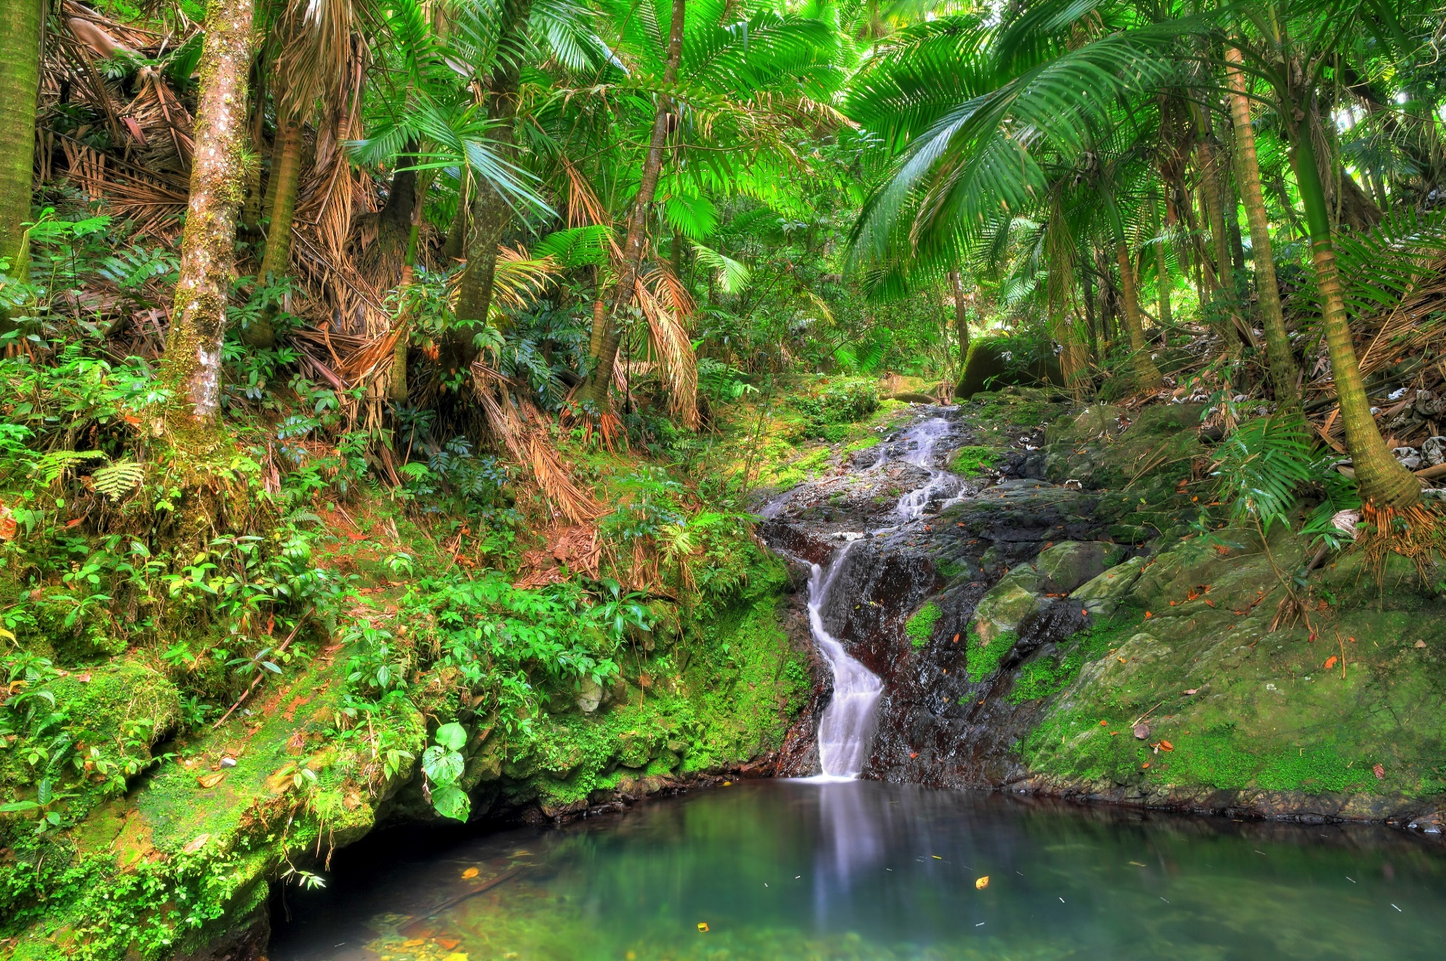
Tropical rainforests
Notes:
Tropical forests are found near the Earth's equator. There are two main types of tropical forest: the rainforest and the seasonal forest. Both get more than 8.5 feet of rain every year. Seasonal forests have a wet season and a dry season. However, in the rainforest there isn't a dry season. In a tropical rainforest it rains regularly throughout the year. Tropical forests are the home to a huge number of animal species. In fact, the number of species living in these two types of tropical forests is more than all other habitats combined.
Some of the animals that live in tropical rain forests include:
Bearded Dragon, Bird of paradise, Bushbaby, Chameleon, Cricket, Iguana, Lemur, Monkey, Tarantula and Toad.

Slide 10
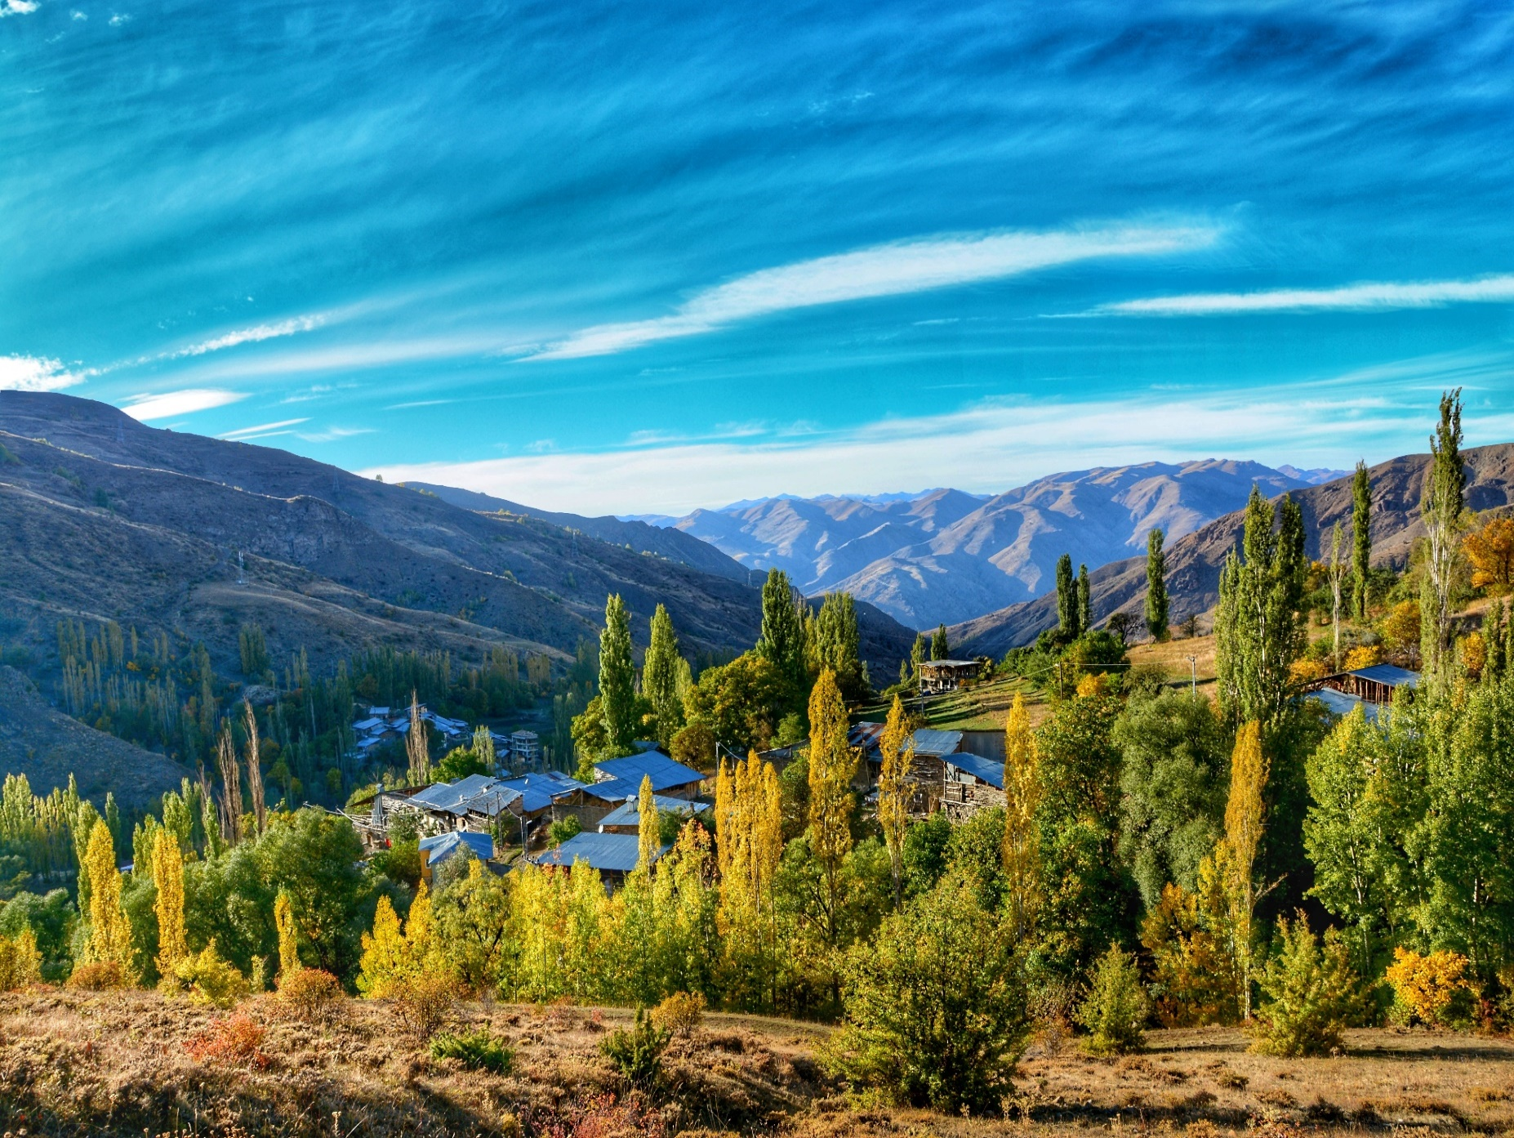
Mountains
Notes:
Mountain habitats vary dramatically from the base to the peak of the mountains. On the mountain tops temperatures are colder, oxygen is scarcer, and the sun is harsher. As the climate changes, the plant and animal life between elevations also changes. On the highest mountain peaks the environmental conditions cannot support tree life. The part of a mountain where trees stop growing is called the tree line. Few, if any, trees will grow above this height. Many animal species live in the lower altitudes, but only the hardiest species can live year round above the tree line, where the air is thinnest and there are no trees.
Some of the animals that live in mountains all over the world include:
African Buffalo, American Black Bear, Brown Bear, Deer, Giant Panda, Snow Leopard, Red Panda and Wolf.

Slide 11
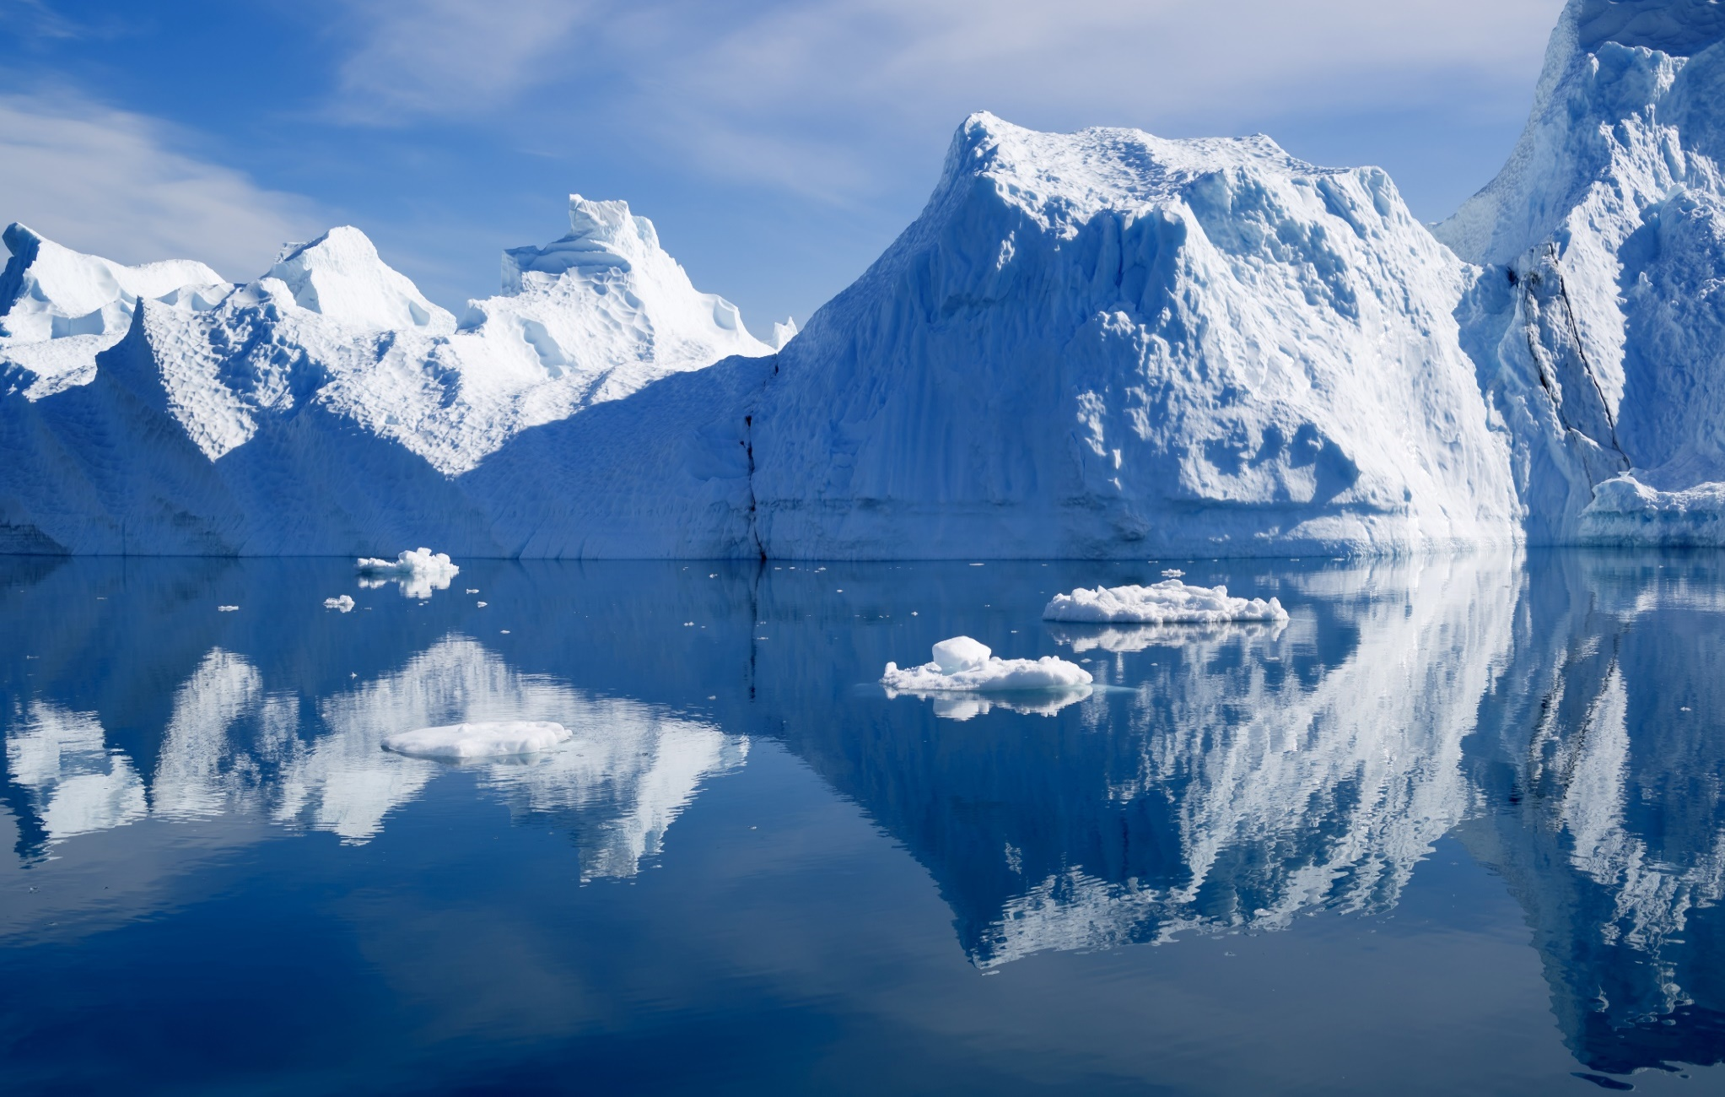
Polar regions
Notes:
Polar Regions are the coldest places on earth. The Arctic of the north is partly frozen ocean surrounded by mostly barren, and often frozen, land. The south's Antarctic is an ice covered continent that is surrounded by stormy oceans. Although the two polar regions are similar in many ways, the animal life between them differs. In the Arctic many animals live on the land. In the Antarctic the animals live almost entirely where the ice meets the ocean. Fewer animal species live in the Antarctic than in the Arctic.
Some of the animals that live in mountains all over the world include:
Arctic Fox, Coyote, Deer, Owl, Penguin, Polar Bear, Seal, Walrus, Whale and Wolf.

Slide 12
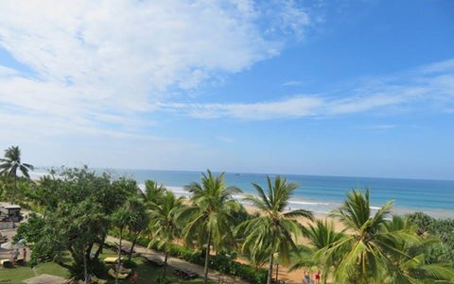
Oceans
Notes:
Oceans are by far the largest animal habitat on earth. The oceans are so huge it is hard for scientists to explore them. Information on ocean animals is not as complete as information on land animals. It is known that animal life can be found at all depths of the ocean, from the surface to the deepest trenches that are over seven miles below the surface. Some ocean animals spend most of their life in the waters near the land. Others live most of their life in the deeper open sea. Even though the open sea is the largest habitat, it is estimated that only five percent of the world's animal species live there.
Some of the animals that live in mountains all over the world include:
Angelfish, Clownfish, Crab, Calm, Dolphin, Eel, Lobster, Octopus, Orca, Oyster, Sea lion, Seal, Shrimp, Squid, Starfish, Stingray and Turtle.

Slide 13
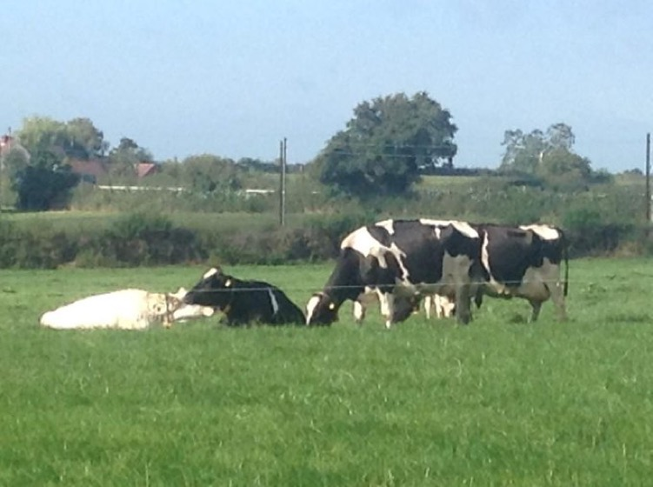
Cities, towns and farmland
Notes:
Urban areas (cities and towns) and farms are the home to animals which are kept and raised by people. Urban and farm habitats are also the home of animals that are able to survive or thrive in human populated areas. This includes pets, farm animals, birds, small mammals, and lots of invertebrates (bugs!). Many species have adapted to urban life successfully. The cities of the world provide a reliable food source to animals such as rats and pigeons. The homes of city and suburban areas offer shelter and warmth to not only our pets, but unwanted visitors like cockroaches, houseflies and spiders.
Some of the animals that live in mountains all over the world include:
Bee, Beetle, Bluebird, Cat, Caterpillar, Cattle (cows, sheep and pigs), Chicken, Donkey, Ferret, Fox, Frog, Horse, Llama, Owl, Rabbit, Raccoon, Wasp and Wren.

Slide 14
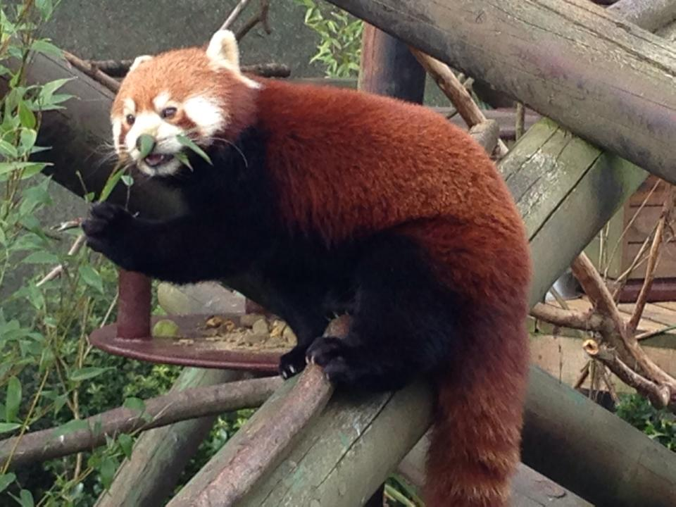
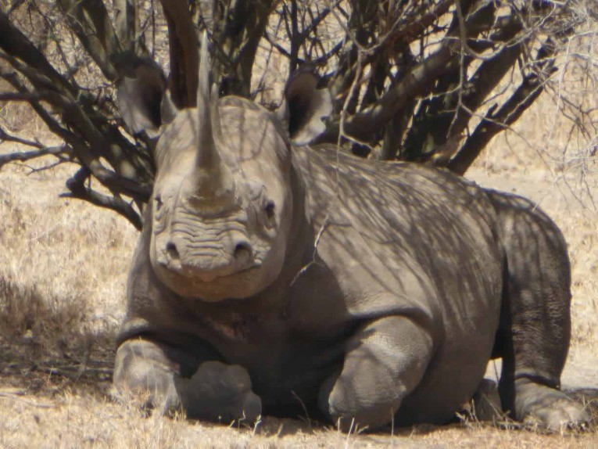
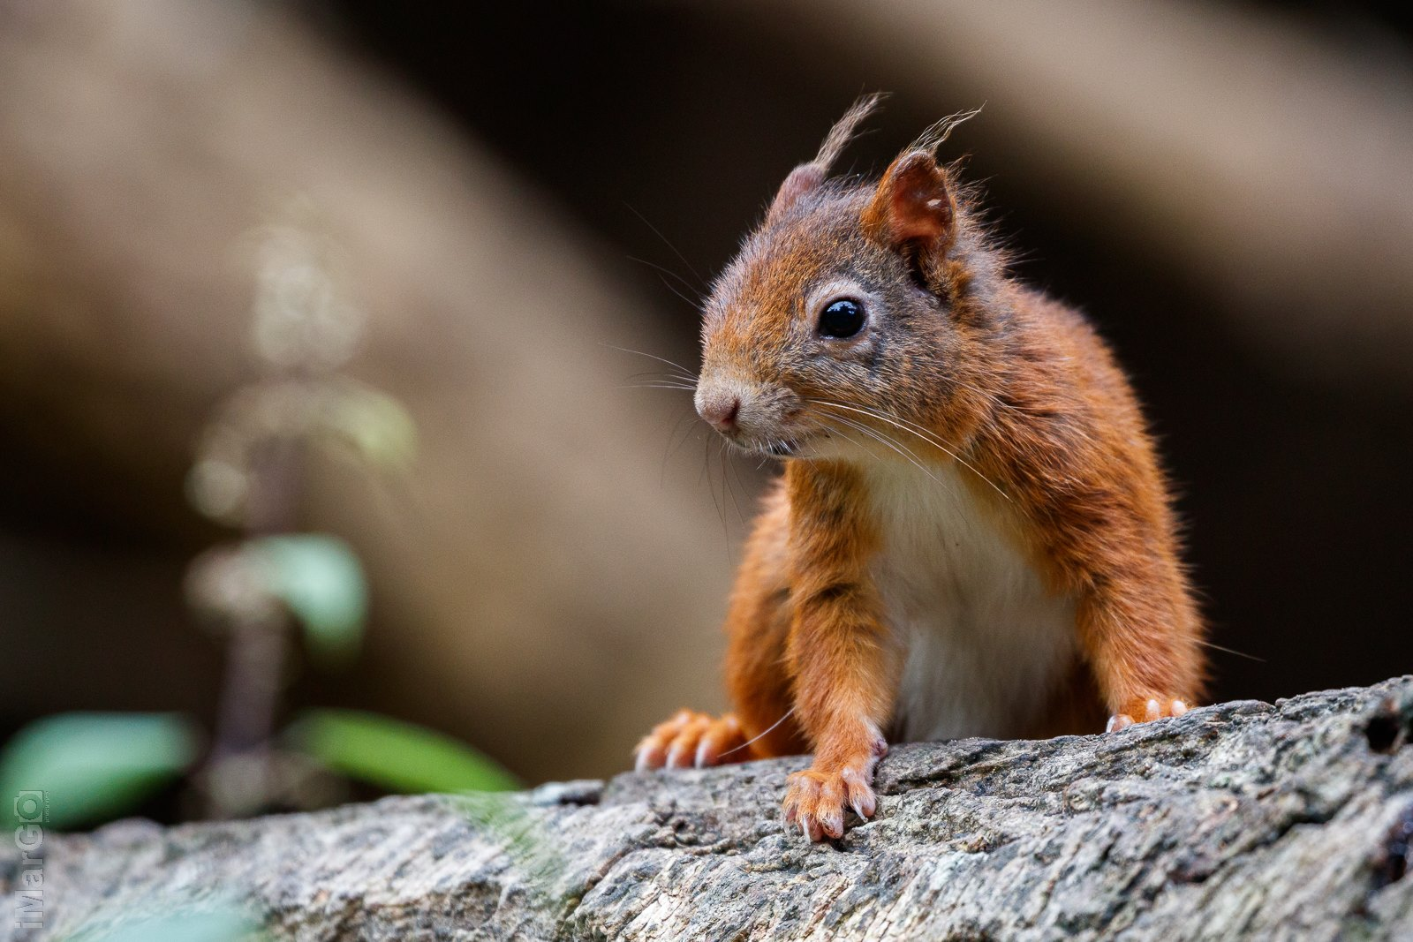
Endangered animals
Notes:
An endangered species is an animal which has been categorised as being likely to become extinct.
Some examples of endangered animals include:
Amur Leopard, Black Rhino, Malayan Tiger, Orangutan, Asian Elephant, Bengal Tiger, Blue Whale, Chimpanzee, Green Turtle, Indian Elephant, Red Panda and Sea Lion.

Slide 15
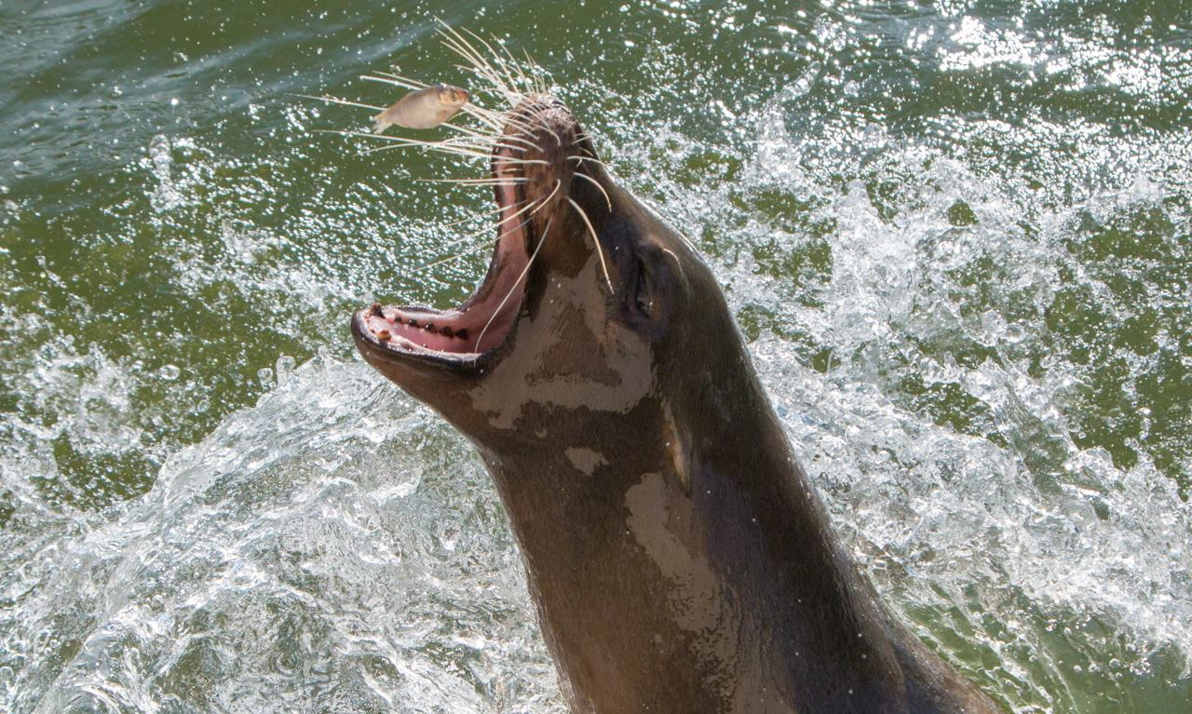
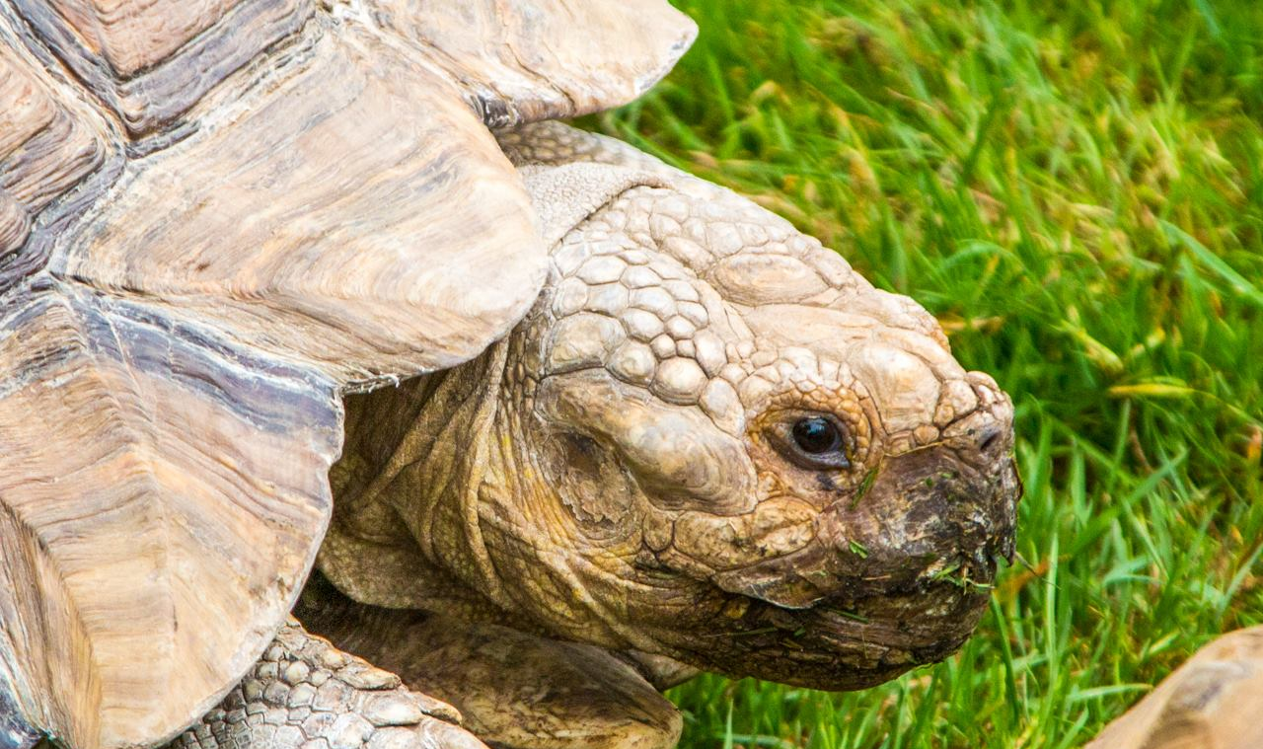
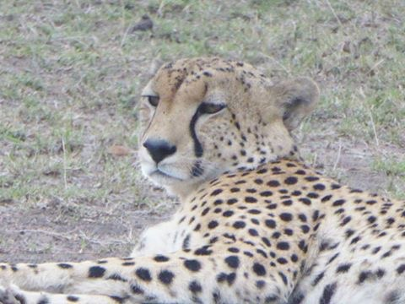
Endangered animals

Slide 16
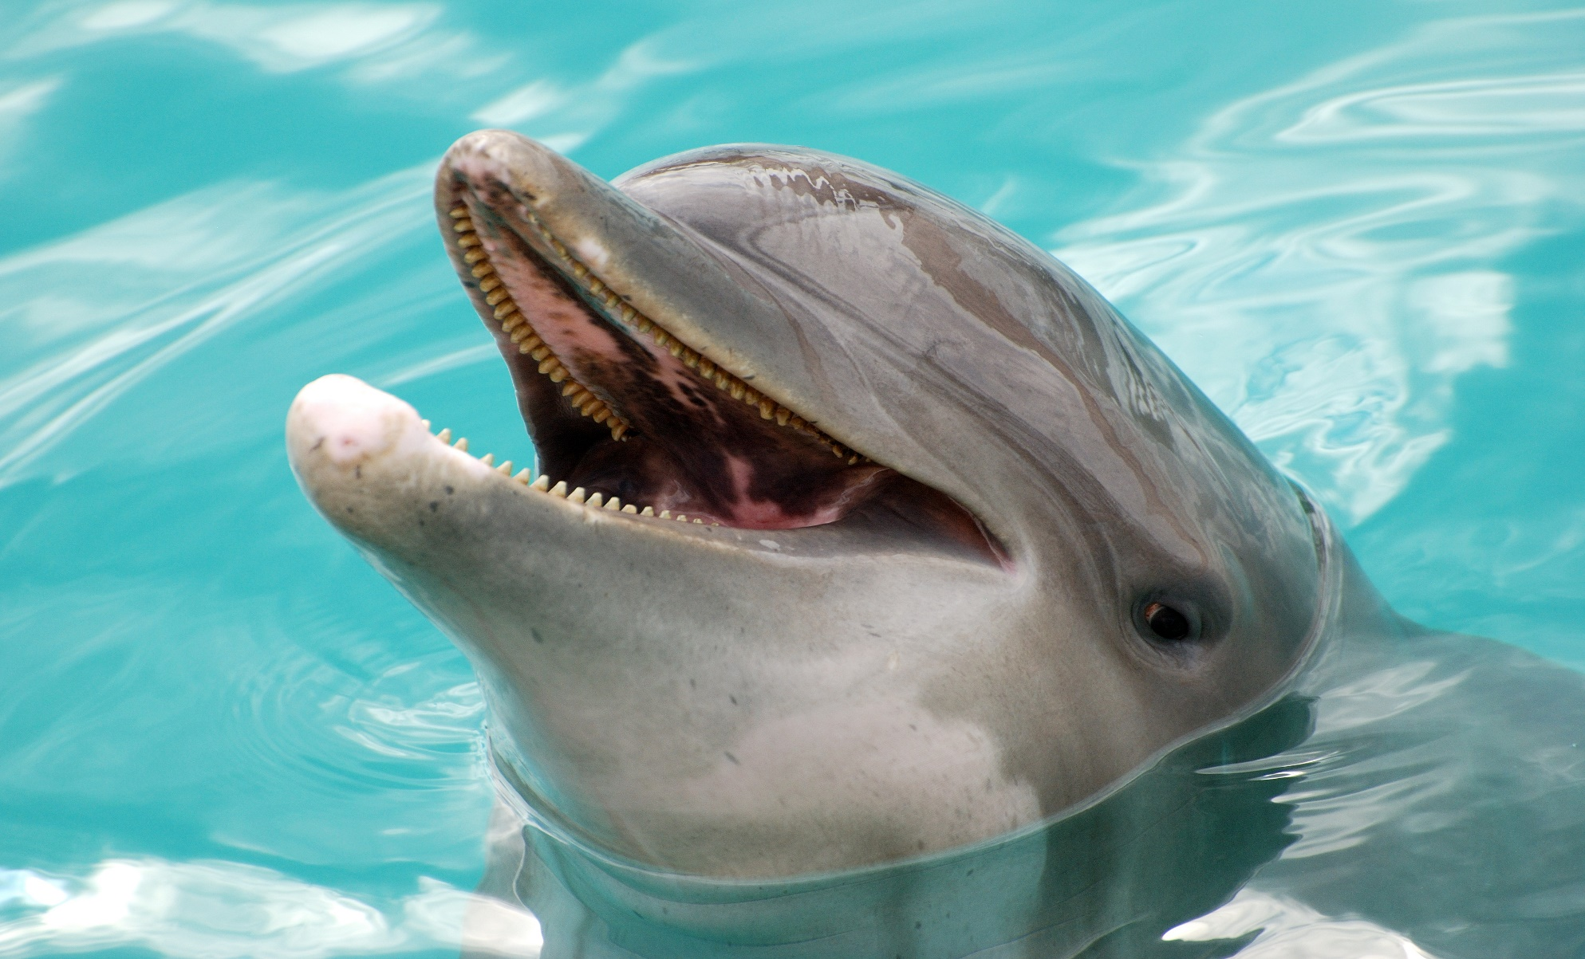
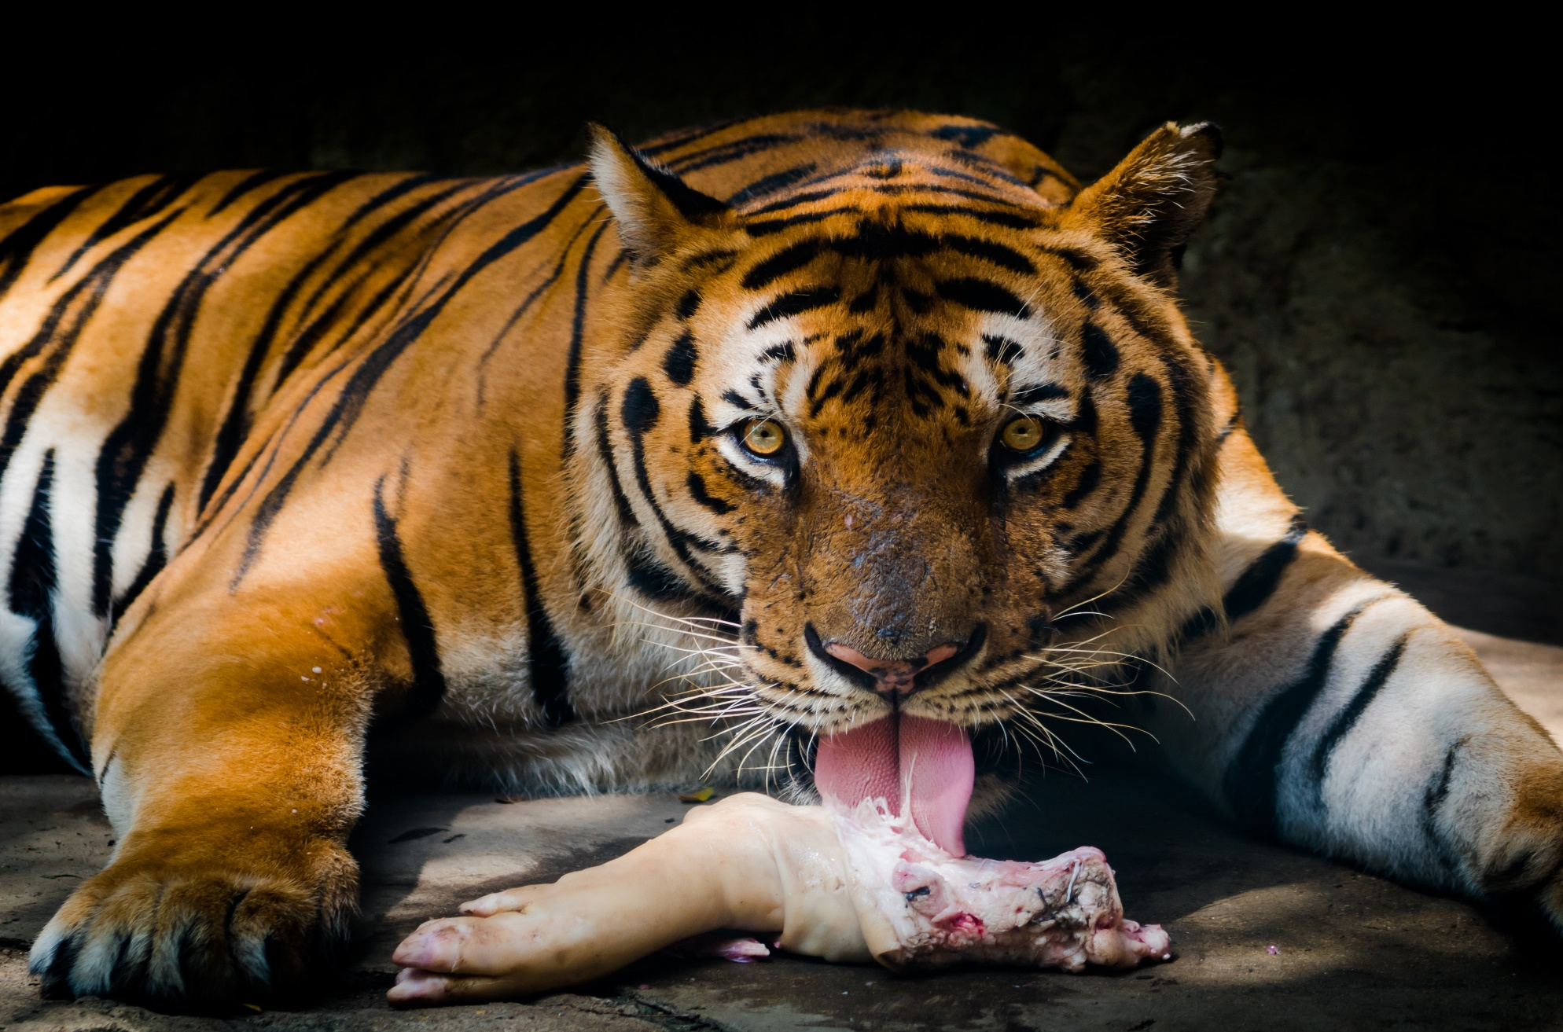
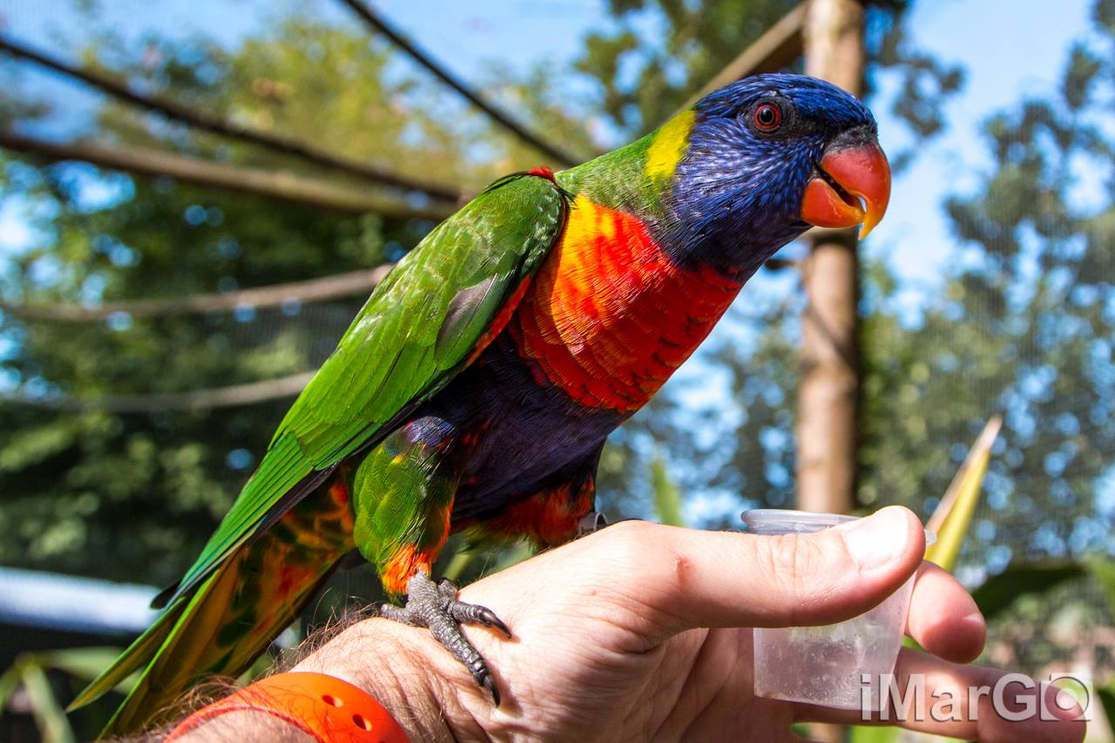
Endangered animals

Slide 17
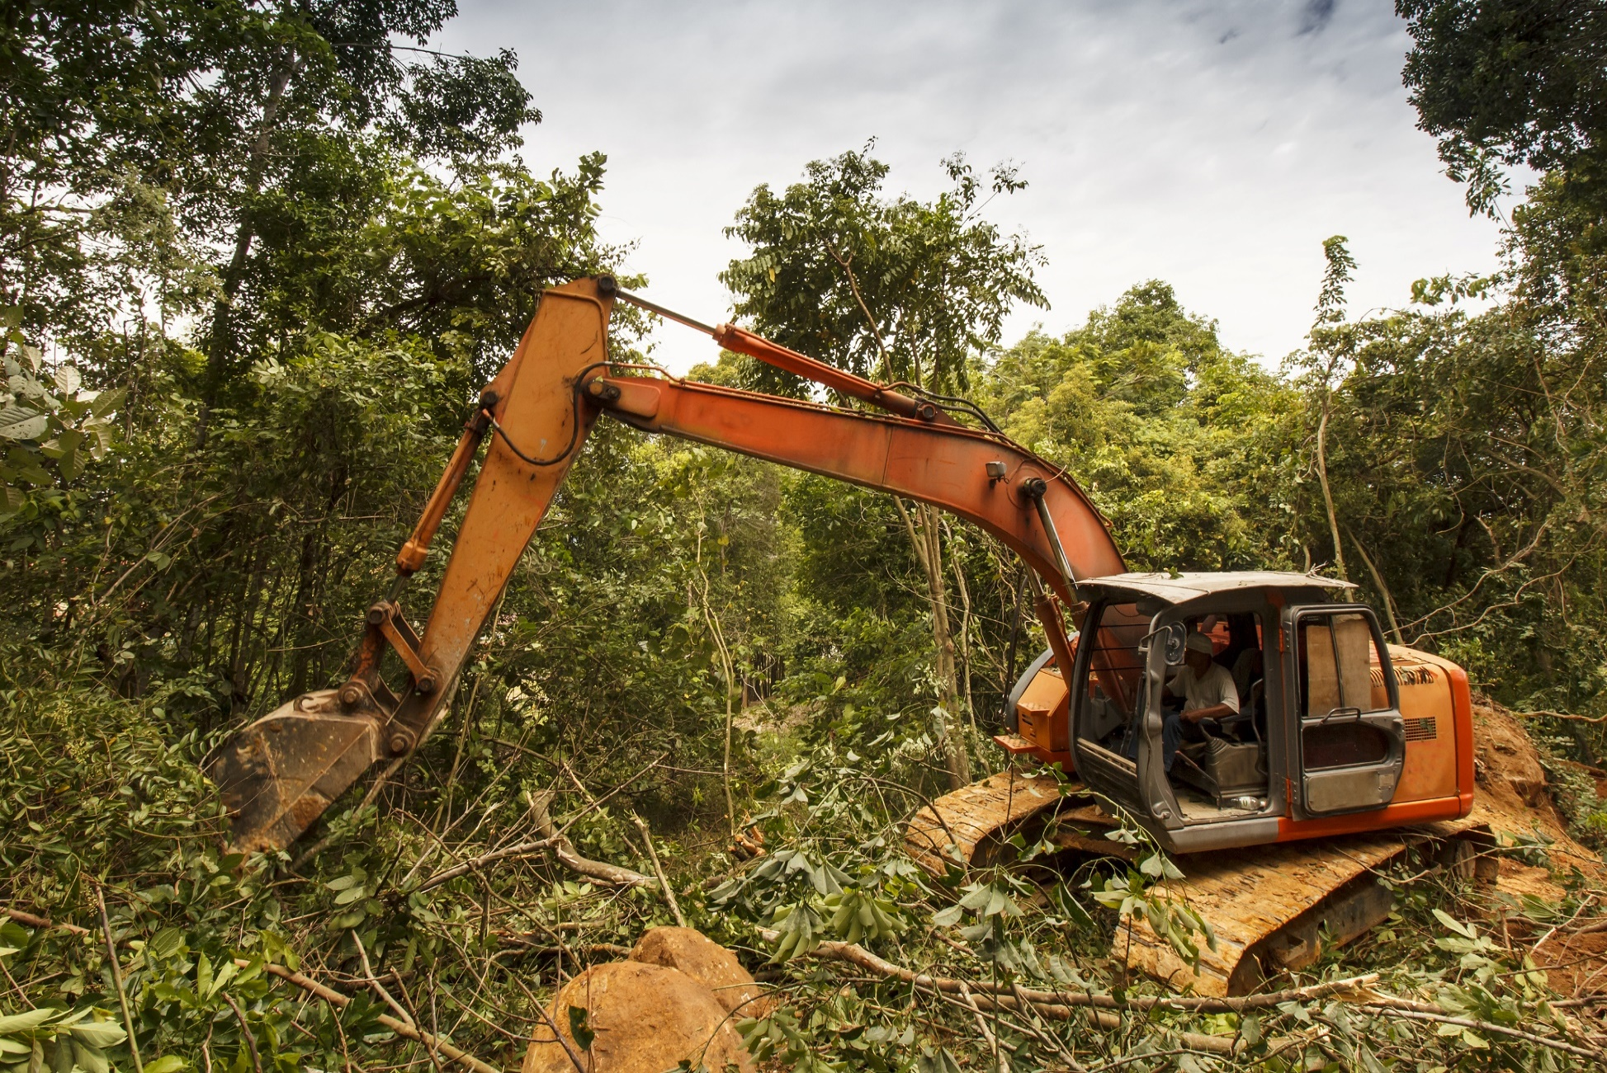
Habitat destruction/deforestation
Notes:
Currently habitat destruction by humans is one of the major causes of extinctions around the world.
Natural habitats are destroyed by humans in the following ways:
claiming land for farming
building cities
removing resources (mining / logging)
toxic contamination

Slide 18
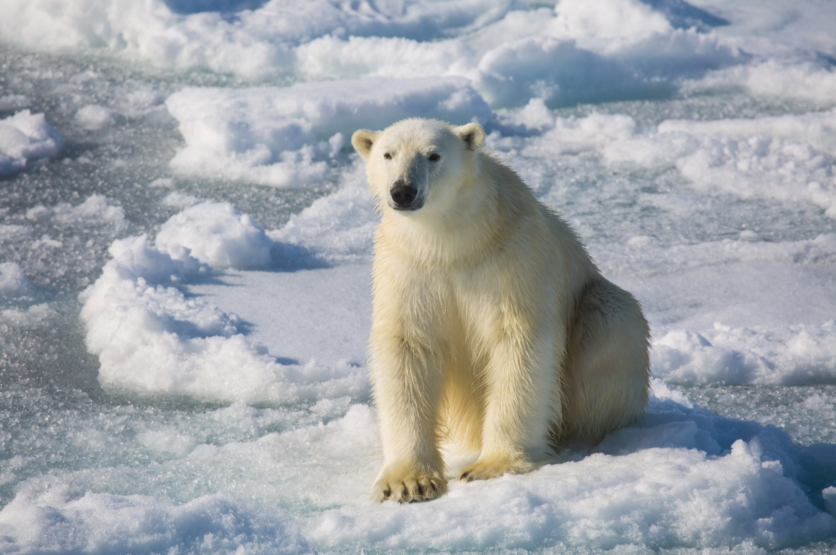
Global Warming
Notes:
The process of global warming can change the conditions in a habitat to such an extent that resident species can no longer live there. If a species is specifically adapted to that habitat then it can threaten the species as it is incapable of surviving anywhere else.

Slide 19
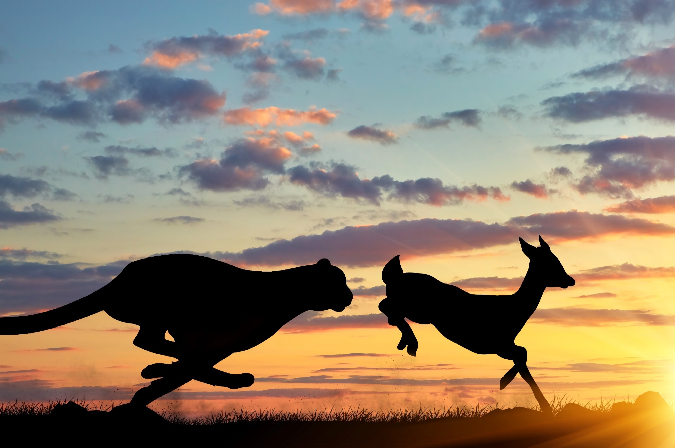
Prey loss
Notes:
Loss If the food that an animal feeds on becomes extinct then the animal itself may become endangered

Slide 20
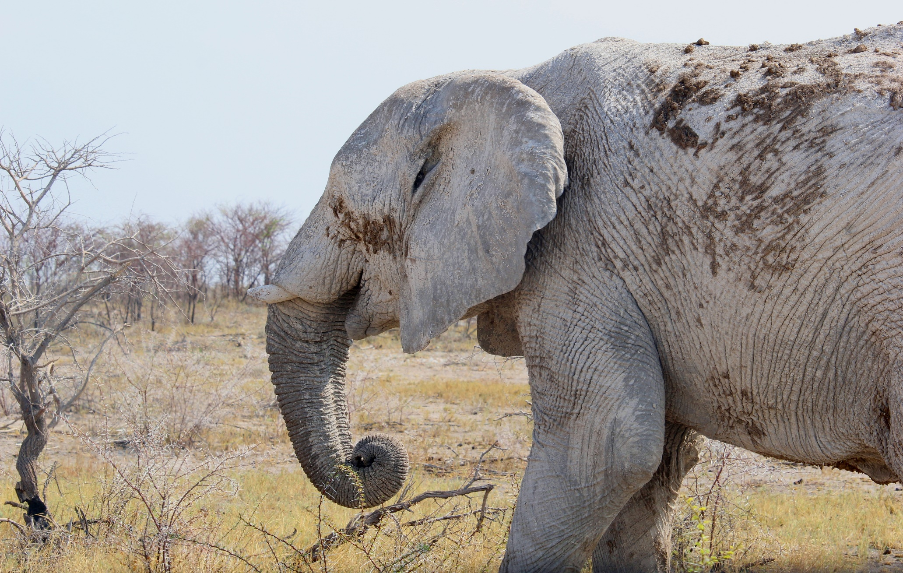
Disease
Notes:
Disease can spread amongst a species by parasites such as fleas and mosquitos.
Poor treatment and abuse can also lead to disease. Poachers have cut the tusks of the poor elephant in this image and this has led to him becoming unwell. Elephant tusks are made of a material called ivory, which can be sold for a lot of money.

Slide 21
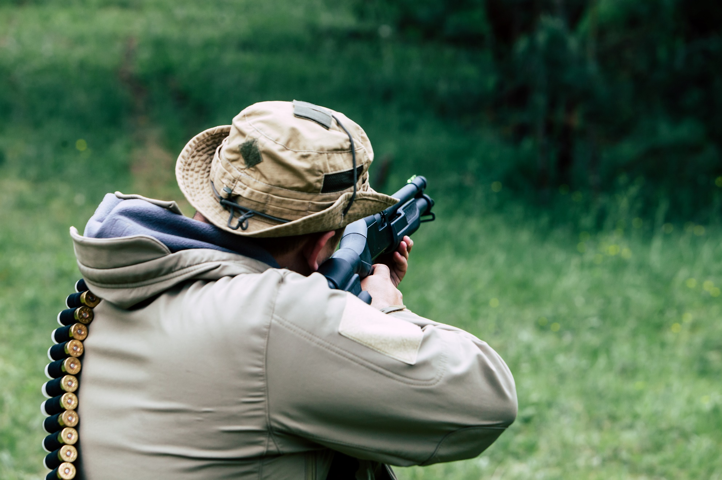
Hunting
Notes:
Hunting either for meat or body parts can put significant pressure on populations.

Slide 22
https://www.youtube.com/watch?v=-jG-0wojixs
Notes:
Play the video (K9 Killer)

Slide 23
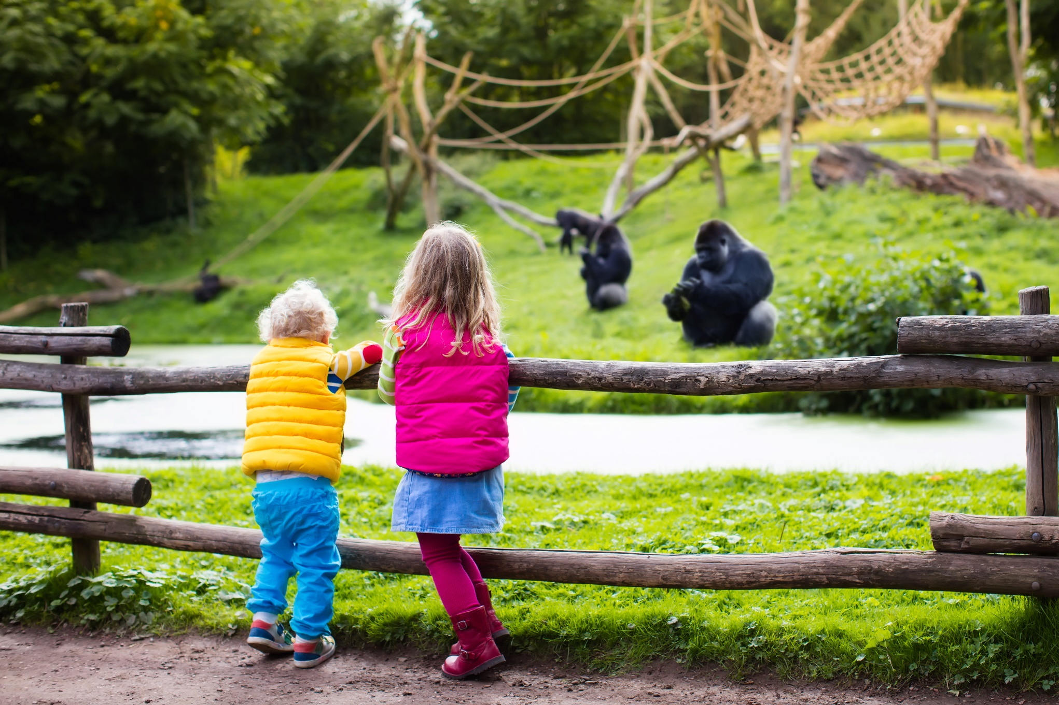
Animals in captivity
Notes:
Ask the pupils if they’ve ever visited a zoo.
Ask the pupils to discuss with their partner (or in groups) if they think zoos are a good thing or not.
Discuss as a class.
Pros of zoos include:
They prevent endangered animals from being hunted.
They provide a safe haven for injured animals that wouldn’t survive in the wild.
Zoos play a big part in education. They allow people to learn about animals from around the world and raise awareness of welfare issues.
Cons of zoos include:
Space. For example, elephants travel long distances in the wild in large groups. They can’t do this in a zoo.
Stress. Animals suffer negative psychological effects when kept in a confined space.
Animals born in zoos never get to see their natural habitat (Madagascar films).
Visitors don’t always respect the animals. They sometimes tease them and throw things into their cages.

Slide 24

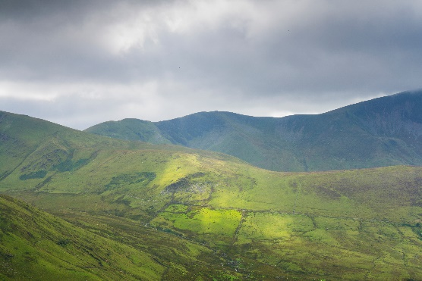
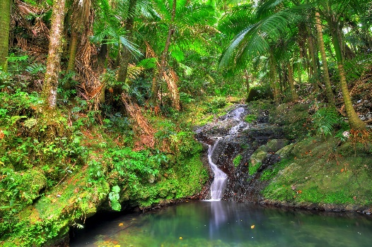

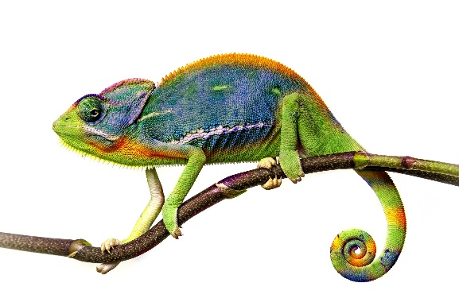
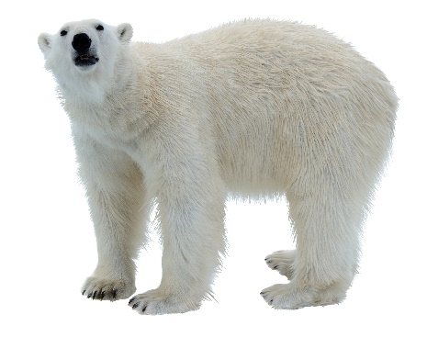
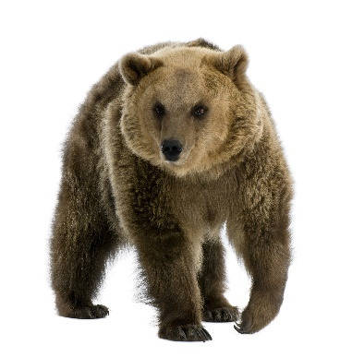
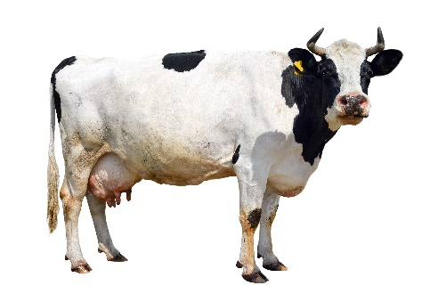
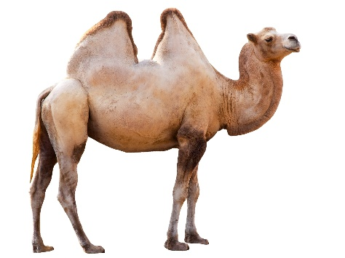
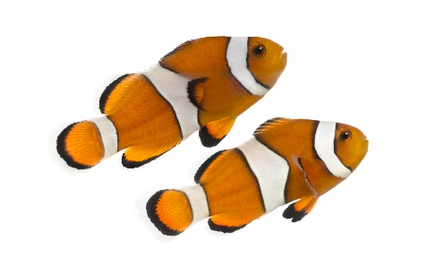
Match the animal to its habitat
1.
2.
3.
4.
5.
6.
f)
a)
b)
c)
d)
e)
Activity
Notes:
Ask the pupils to match the animal to its habitat.
Answers:
1 d
2 c
3 a
4 e
5 f
6 b

Slide 25
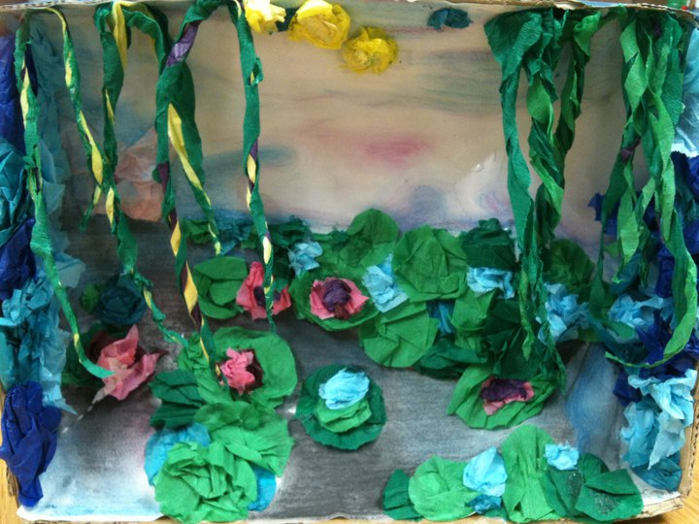
Habitat activity
Notes:
Explain to the pupils that they’re going to make a habitat shoe box.
They need to start by picking a habitat, researching what features that area has and what animals live within it.
This task will take a few lessons or a half day.
These can be displayed around the school and/or parents can be invited in to view their work.

Slide 26


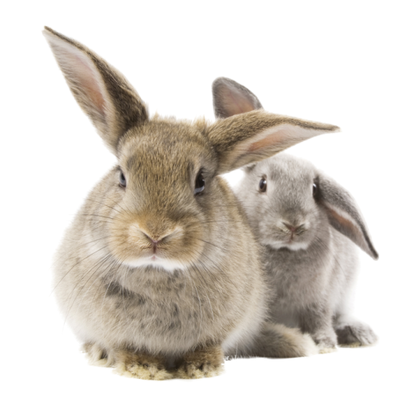
Thanks!

